Slide 1
Agricultural entrepreneurship
Global Forum for Rural Advisory Services (GFRAS)
Part of the New Extensionist Learning Kit

Slide 2
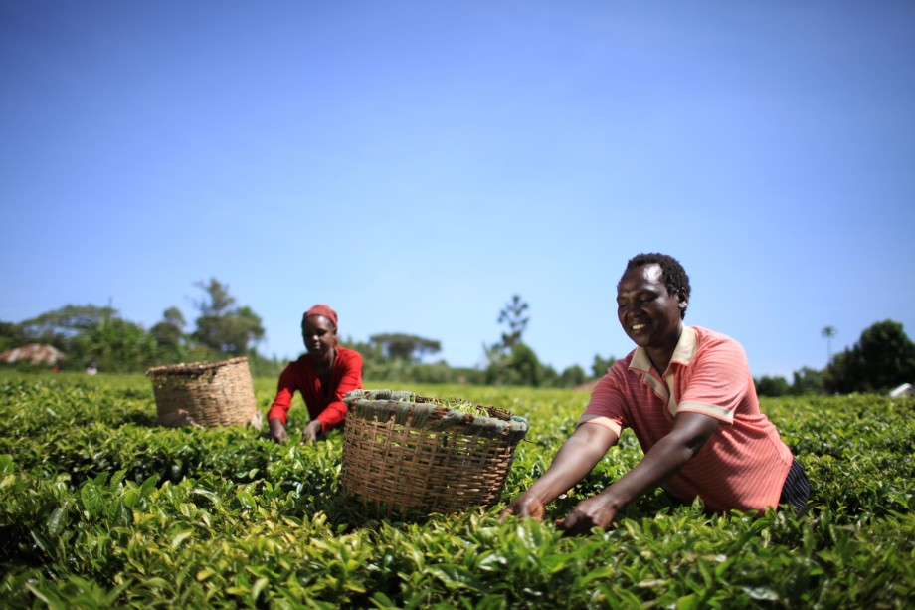
What is agri-entrepreneurship?
Entrepreneurship that relates to the marketing and production of various agricultural products, as well as agricultural inputs.

Slide 3
Agricultural entrepreneurship
Study Unit 1

Slide 4
Overview
Study unit 1 is about:
The role of the extensionist in agri-enterprise development
The business idea

Slide 5
Why agri-entrepreneurship?
Latest trend in extension work:
Agriculture should be seen as a commercial activity
Farmers are seen as entrepreneurs
Farmer groups and cooperatives are seen as enterprises
The focus of extension services move from poverty reduction to wealth creation

Slide 6
Pluralistic extension
Extension that is characterised by the inclusion, interaction and coordination of multiple providers and services, funding options and multiple information sources

Slide 7
Benefits of pluralistic extension
Addresses the need for specific extension services for specific contexts, economic enterprises, livelihood operations and for different farmer categories
Addresses the wide variety of demands, while making better use of the variety of service providers available
Develops better services through cooperation between community-based, public and private sector actors
Shifts the coordination and accountability between extension services and other service providers to the level of the farmers, farmer groups and organisations
Provides a system in which the quality and content of extension services are more responsive to the needs and priorities of farmers

Slide 8
Role players in pluralistic extension
Farmers and lead farmers
Farmer groups and associations
Local volunteer agents
Commission agents
Business support services
NGO field agents
Private sector service providers

Slide 9

Clients of agri-entrepreneurship
Three categories of farmers, as identified by Bill Vorley:
Rural World 1: Globally competitive farms linked to formal markets
Rural World 2: Locally oriented farmers
Rural World 3: Farmers with fragile livelihood and limited access to resources

Slide 10
Farmer types in agri-entrepreneurship
Within the three categories of farmers, the following farmer types are potential agri-entrepreneurs:
Women farmers
Small-scale family farmers
Medium-scale farmers
Commercial farmers

Slide 11
Characteristics of a successful entrepreneur
Has the initiative, drive and ability to identify and take advantage of opportunities
Is always looking for opportunities to improve and expand their businesses
Thrives on change and copes well with risk and uncertainty
Knows how to identify and evaluate risks and is willing to take calculated risks, while accepting responsibility for both profits and losses
Is a creative problem-solver, understands the decision-making process and enjoys making decisions
Establishes strong partnerships and other relationships and works well with other people
Is an innovator who is always looking for better and more profitable ways to do things

Slide 12

Agri entrepreneurs as a new type of innovator
In this interview, Andy Hall, Researcher in the area of Innovation Processes and Agriculture, answers a few questions regarding agri-entrepreneurs as a new kind of innovator and the roles they play in putting research into use.

Slide 13
Elements involved in starting a business
Identifying the type of farming business
Identifying resources that the farming business will require
Analyse the cost of resources
Evaluate the identified resources
Identify risks

Slide 14
Why become an entrepreneur?
Ask the client the following questions:
What is the driving force behind your wish to set up a new business?
Do you know exactly what your business will do?
Will you be making the most of your strengths?
Can you make decisions and work well on your own?
Will your business make enough money for you?

Slide 15
Rewards of entrepreneurship
Nature of reward | The entrepreneur
Personal satisfaction | Wants to do something different and wants to choose their own way of doing things.
Financial gain | Sees an opportunity to make a profit by starting their own business enterprise
Independence | Seeks the opportunity to make his/her own decisions and to set their own targets and standards
Self-fulfilment | Wants to use their own skills and abilities more meaningfully and profitably

Slide 16
Assess client readiness for a business approach
Problem-solving | Do you come up with solutions to problems in your farming operation or do you ask for help?
Facing challenges | Do you see failure at a task as a challenge or do you give up?
Money matters | Do you believe hard work will pay off?
Communication | Can you explain processes and procedures to others? Can you express yourself clearly when communicating with your suppliers, buyers and other role players?

Slide 17
Elements of a good business opportunity
There is a demand in the market for the product
The product meets a need or solves a problem
The business opportunity works in a particular location
The farmer has the resources to take on the business opportunity
The farmer can provide the product at the right price that attracts customers, while making a profit
The timing for the business is right

Slide 18
Individual farm plans
Extension agents should develop individual plans for farmers that focus on the use of existing assets, market options and business capacity.

Slide 19
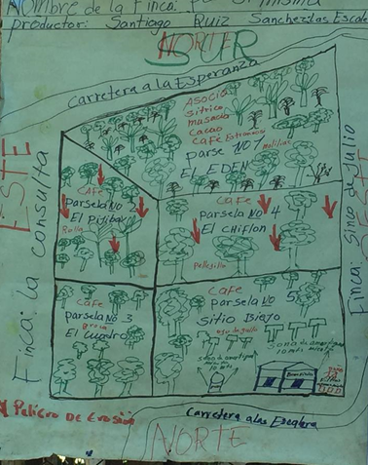
Farm plan for a coffee farmer in Nicaragua

Slide 20
Steps in creating a farm plan
Create a profile of the farmer.
List the key income crops and the main food items that are produced.
Review and prioritise key challenges that the farmer is experiencing.
Use visioning to map the current situation vs. goals, assets and skills.
Develop a farm plan with goals for the main plots over the next seasonal cycle
Prepare an implementation plan, with achievable steps, with the farmer.
Develop a farm diary so that the farmer can follow the steps.
Set indicators for monitoring progress.

Slide 21
Group plans for farmers
Examples of methods for farmer organisation in market linkage include:
Farmer group management
Financial skills and access to credit
Linkage to agri-dealer networks
Value chain support within the chain
Collective marketing
Agent networks
Community fee-based service providers

Slide 22
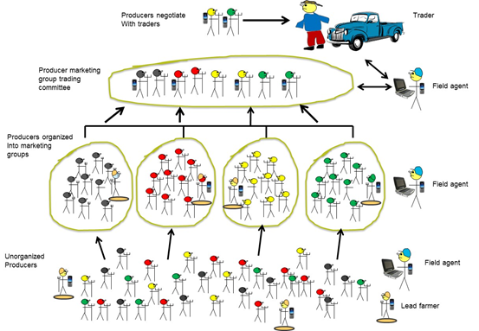
Example of a collective marketing organisation

Slide 23
Value chain support
Where there is reluctance from farmers to work in cooperatives, modern extension services need to devise different systems of organisation that support greater collective action.
NGOs have piloted a number of interim structures that support better market coordination of farmers.

Slide 24
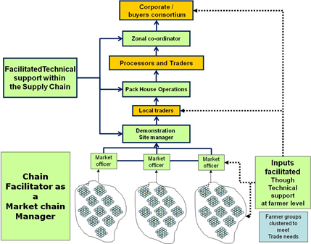
Extension support to value chain
This type of approach can be very effective in introducing farmers into a formal supply chain, but the costs are generally high.

Slide 25
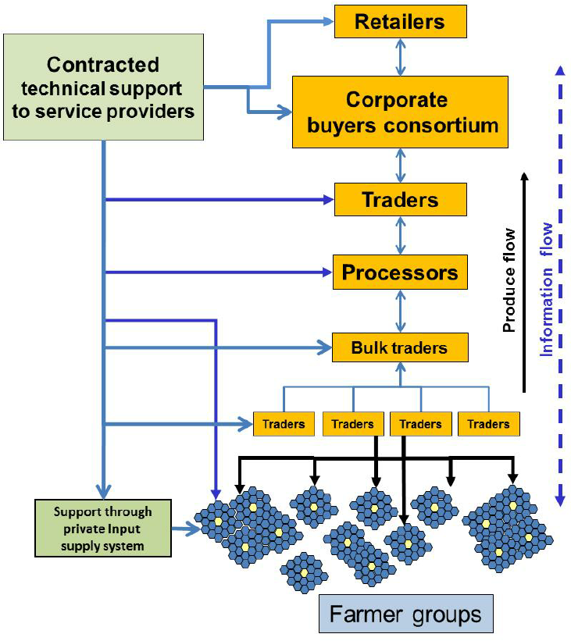
Extension support to value chain
Extension support as an external facilitator

Slide 26
Defining a business idea
Identify a product or service
Define the market
Identify main competitors
Identify resources

Slide 27
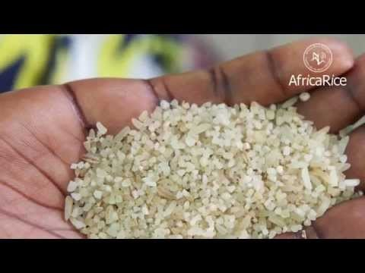
101 Ways to make money in Africa: business ideas for entrepreneurs in Africa: rice
In this short video, you'll see how AfricaRice, a local company, is using rice produced by local farmers to create more market friendly products for the local market. This innovative strategy is sure to significantly boost the value of locally produced rice.

Slide 28
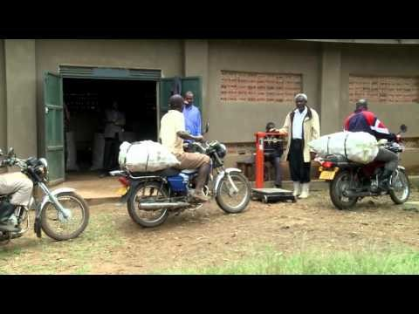
Farming as a business in Eastern Africa
In this video, you will see success stories from the FAO Food Security through Commercialization of Agriculture (FSCA) Programme funded by the Italian Development Cooperation in Eastern Africa.

Slide 29
Viability of the business idea
A viable business idea:
Covers the expenses of producing or manufacturing a product
Generates adequate profit
Withstands business risks
Meets the goals set by the owner

Slide 30
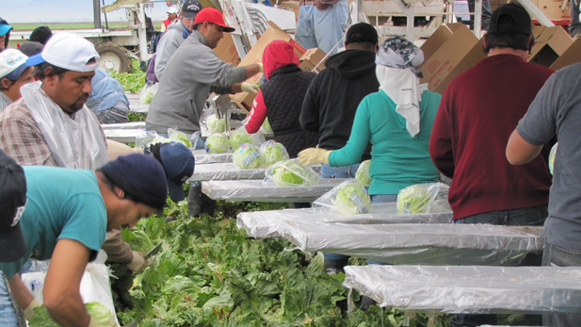
The business gap and the niche market
Business gaps range from the need for new products to changing a current product, or offering it in an alternative way, e.g. importing bulked soybean or providing organic coffee to the international market.

Slide 31
The feasibility study
The feasibility study is a tool to study the viability of a business idea by:
Identifying potential problems and opportunities
Determining objectives
Defining successful outcomes
Assessing costs and benefits involved in alternatives for solving problems

Slide 32
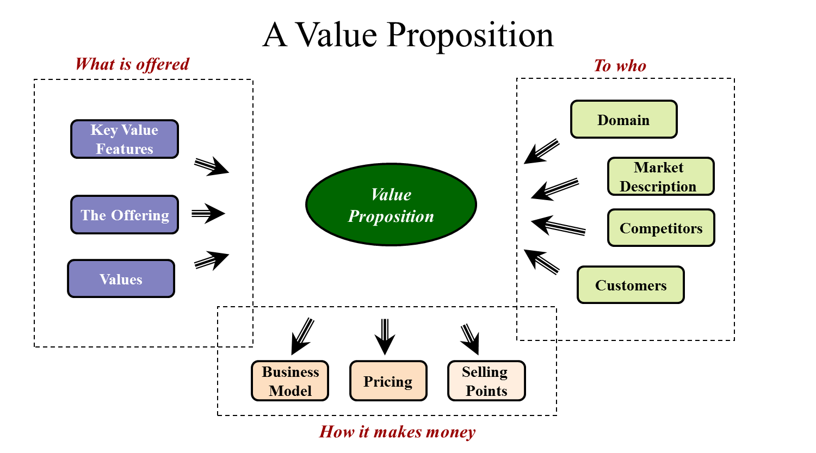
Define a value proposition

Slide 33
Steps in defining a value proposition
Step 1: Know the customer
Step 3: Know the competitors
Step 4: Write a customer-oriented value proposition
Step 2: Know the product

Slide 34
Identify the client’s customers
Customers in the informal market
Customers in the formal market
Informal assembly markets
Informal wholesale markets
Informal retail customers
Supermarkets
Hotels and restaurants
Feed markets
Public sector markets
Export markets

Slide 35
Key activities in agri-business
Crop production activities
Marketing and sales
Accounting activities
Administrative activities
Managing farmer groups and human resources

Slide 36
Key skills involved in running a business
Study unit 2

Slide 37
Overview
Study unit 2 is about
The key skills needed to run a farming enterprise, including:
Business planning
Market analysis, marketing and sales
Decision-making
Financial and bookkeeping basics
Production mapping and management
Negotiation with partners
Customer relationship development and management
Employee training.

Slide 38
Evaluating key skills
Production operating skills
Short and long-term planning and goal setting skills
Decision-making skills
Problem identification and problem-solving skills
Communication skills
Human resource management and training skills
Negotiation skills
Calculation sills
Bookkeeping and basic financial skills.

Slide 39
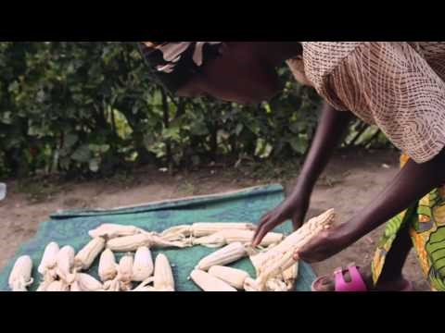
Expanding farmers’ skills: One Acre Fund
One Acre Fund’s Andrew Youn on expanding access to financial services and skills training for smallholder farmers in Africa.

Slide 40
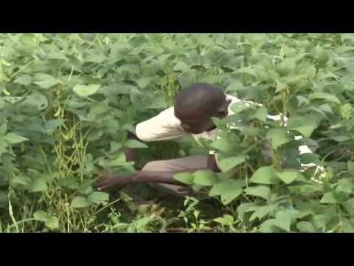
Farmers taught financial literacy skills: Uganda
In this video, NTV Uganda visited a group of farmers in Aduk Sub County, Apac district, who have formed their own savings group. This is an example of the farmers learning financial literacy to gain from their agri-enterprise.

Slide 41
Identify markets, map resources and conduct business planning
Study unit 3

Slide 42
Overview
Study unit 3 is about:
Identifying market opportunities
Managing key activities and partners in a business enterprise
Conducting business planning, from the business canvas to the business plan

Slide 43
Market opportunity identification
MOI is a systematic method that helps extension agents and farmers evaluate:
Market demand and buying conditions for existing products with reference to collective marketing within a group;
Market options for new products to encourage diversification, with an emphasis on higher value goods; and
Market options for value-added products, so that service providers can assist farmers in capturing more value from their raw goods.

Slide 44
Steps in the MOI process
MOI STEP 1:
Organise a market survey team
MOI STEP 3:
Assess and select market options
MOI STEP 4:
Conduct detailed analysis
MOI STEP 2:
Design an MOI questionnaire or checklist

Slide 45
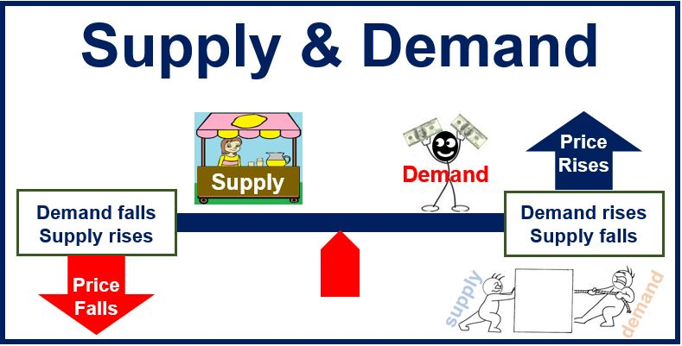
http://marketbusinessnews.com/financial-glossary/supply-and-demand/

Slide 46
Key buying conditions
Crop type and variety that buyers demand;
Prices that buyers are offering;
Quality criteria and product grading;
Volume of sales by buyers; and
Frequency of purchase

Slide 47
Interviewing buyers
Do
Do not
Be courteous
Listen attentively
Maintain control
Probe
Observe signals of nonverbal communication, such as body language
Be patient
Keep the buyer at ease
Maintain self-control
Continue an interview unnecessarily
Assume that an answer is finished or is leading nowhere
Talk instead of listen
Influence the buyer; and
Use a tape recorder: it is an indication of poor listening skills

Slide 48

The sales agreement
The sales agreement with the farmer or agri-entrepreneur and the buyer - which can be a formal contract or a simple handshake - serves as the basis of the transaction between the seller and the buyer.

Slide 49
Key activities in production cycle
Land preparation
Planting
Crop production and management
Pest and disease management
Soil and water management
Harvesting and drying
Sales management

Slide 50
Key partners in an agri-enterprise
Local agricultural research stations
Farmers, lead farmers, farmer groups and cooperatives
Input suppliers
Collectors: small, local traders, who buy directly from individual farmers;
Processors
Companies and retailers that buy the product
Financial institutions, e.g. commercial banks
Extension and business development services
Regulatory agencies
Customers who buy the final products

Slide 51
Design an implementation plan: template
Area | Activities | People responsible | Timeframe | Costs
Production
Postharvest processing
Marketing
Sales

Slide 52
Monitor progress: template
 | What went well? | What needs improvement?
Business plan
Pre-production
Production
Post-harvest
Marketing
Profit analysis
Recommended changes

Slide 53
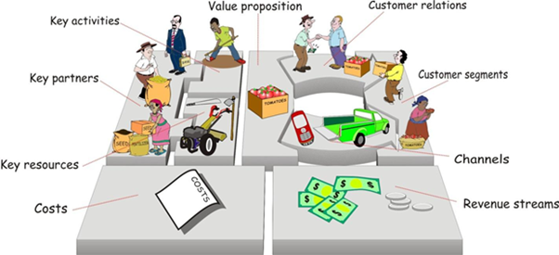
Using the business canvas to visualise the business plan

Slide 54
Areas in the business model canvas
Customers | Buyers, traders or consumers
Value proposition | A statement that describes the unique value of a firm or group’s products
Channels | The way in which the group plans to deliver the product to the buyer
Customer relationships | How the group plans to identify buyers and create and maintain relationships with them
Key resources | The inputs and resources that the group uses to produce the product
Key activities | The activities that the group plans to do to produce the product
Business services and partners | Services and partners that the group uses to produce and market its product
Costs | The costs that the group incurs in order to produce and market the product

Slide 55
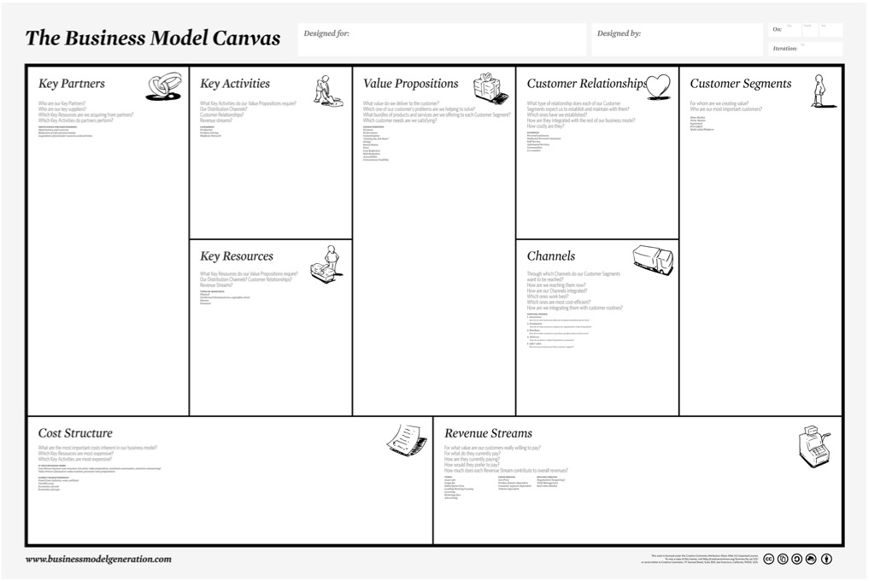
Using the business model canvas

Slide 56
Identify investment needs
How much money is required to start the enterprise?
How much money does the enterprise team have?
How much does it need?
When will it see its first revenue?
When will it break even?
When does it see profit?

Slide 57
Financial management, sales and risk management
Study unit 4

Slide 58
Overview
Study unit 4 is about
Identifying sources of finance, e.g. self-help groups, SACCOs, family lending, commercial banks and e-money
Managing financial resources
Performing sales operations
Conducting risk assessment

Slide 59
Savings options and services
Self-help savings groups, e.g. ROSCAs, ASCAs and SILCs;
Savings and credit cooperatives (SACCOs)
Family lending
Local money lenders and traders
Micro-finance institutes
Commercial banks
E-money (e-credit)

Slide 60
Evaluating savings options
Criteria:
Liquidity (i.e. how easy it is to turn an asset into cash)
The risks associated with savings indicate potential of savings losing their value
The cost associated with savings
The profit associated with savings
Accumulating assets

Slide 61
Household and business finances
Keep separate records for business and household needs
Keep financial records for the business and household in separate filing systems
Decide on a salary from and do not exceed that when making household expenses
Set a budget for the business by using the following steps:
    Keep track of daily income and expenses;
    Determine sources of income and estimate total income; and
    Select expenses and estimate their costs.

Slide 62
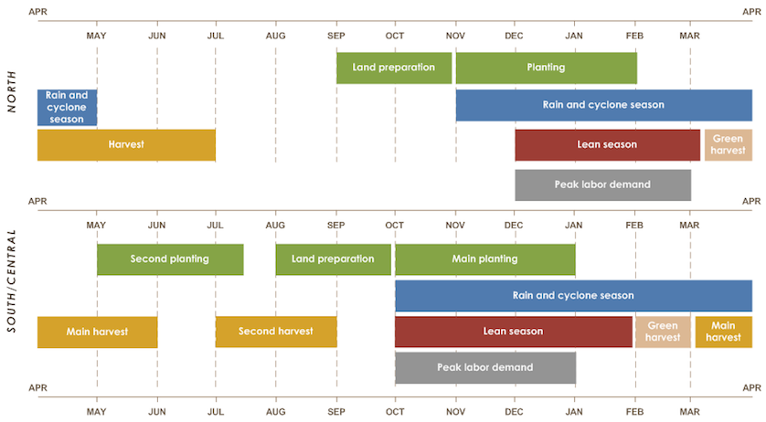
Example of a seasonal calendar

Slide 63

Production costs
Production cost = total of all direct costs
Direct costs relate to the production process, for example:
  Costs of the materials needed to produce the product, which may include seed, fertiliser, irrigation water, etc.
  Labour costs are the total costs involved in paying workers who are directly responsible for the production process, e.g. salaries or wages, payroll taxes and pension fund contributions

Slide 64
Pricing strategies
Cost-based pricing
  Product price includes the operating, manufacturing or production costs;
Value-based pricing
  Based on the customers’ perception of the value of the product and involves customer preferences, convenience, product quality and benefits; and
Competition-based pricing
  Product price is based on what existing and emerging competitors are doing

Slide 65
Steps in sales forecast
Step 1: Estimate potential sales
Step 3: Estimate costs and loss
Step 4: Apply the forecasts
Step 2: Estimate payment timing

Slide 66
Risks in agri-enterprises
Categories of risk
Production risks
Financial risks
Market-related risks
Institutional risks

Slide 67
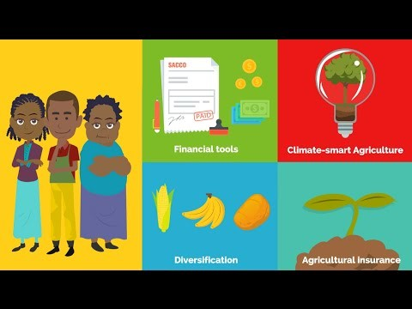
Agricultural risk management: a new way of thinking
The Platform for Agricultural Risk Management (PARM) presents a short animated awareness video to explain how agricultural risk management (ARM) can significantly contribute to improving the resilience of vulnerable rural households by increasing their capacity to absorb and adapt to risks.

Slide 68
Ansoff matrix in risk analysis
 | Existing product | New product
Existing market | 1. Market penetration | 3. New product
New market | 2. Market development | 4. Diversification

Slide 69
Risk management: steps
Step 1: | Identify possible sources of risk, such as environmental factors, unstable market conditions and price changes.
Step 2: | Identify possible outcomes resulting from the sources of risk, including low production and low income periods in the production cycle.
Step 3: | Decide on alternative strategies.
Step 4 | Assess the consequences of each possible outcome of each strategy.
Step 5: | Evaluate the results between the cost of risk and the gains that can be made

Slide 70
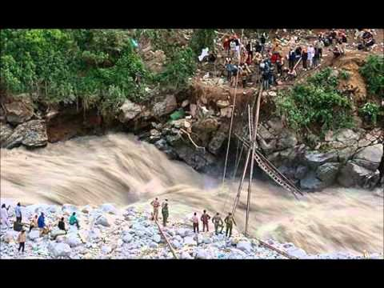
Risk management for farmers in agriculture
This video shows the types of risks associated with farming and what the farmer and organisations can do to manage and minimise the risks involved.
https://www.youtube.com/watch?v=buUGDnXIyGE

Slide 71
Record keeping
Study unit 5

Slide 72
Overview
Study unit 5 is about:
Record keeping methods for:
  Operations record keeping
  Financial record keeping

Slide 73
Production records
Soil conditioning record, including results of regular soil checks
Seed-starting record, including recording of seed sources
Planting record, which records the plot location and planting date
Harvesting scheduling record, which gives information on:
  Crops and varieties harvested
  Amounts harvested
  The crop that is ready for harvest in every month
  Post-harvesting handling methods
  The need for extra labour in the fields for a harvesting period

Slide 74
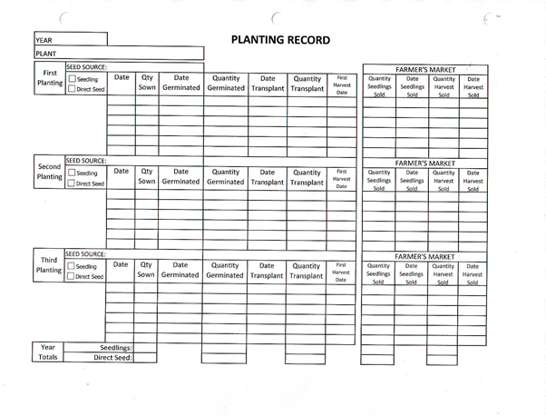
Example of a planting record

Slide 75
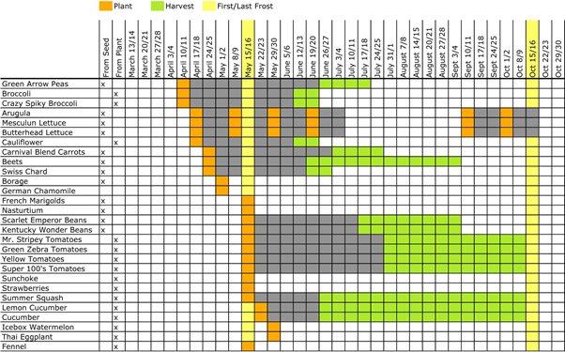
Example of a harvesting schedule

Slide 76
Financial records
Invoices
Receipts
Cash book
Sales book
Payments
Costs
Employment records
Accounts and investments

Slide 77
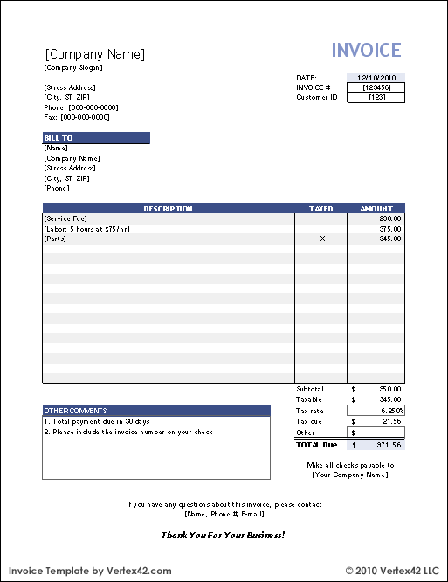
Example of an invoice

Slide 78
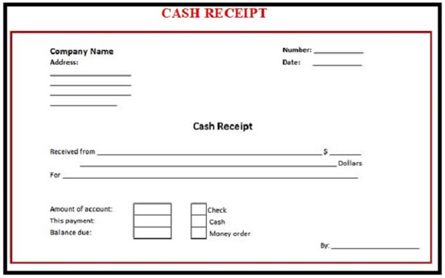
Example of a receipt

Slide 79
Building a business and managing relationships
Study unit 6

Slide 80
Overview
Study unit 6 is about:
Putting plans together
Running an agri-enterprise or entrepreneurship
Monitoring progress
Managing relationships with:
  Teams
  Service providers
  Value chain partners
  Customers

Slide 81
Steps in launching an agri-enterprise
Conduct proper planning;
Test the business idea;
Make sure that you know the market;
Make sure that you know the customer;
Establish cash and other financial resources;
Select a suitable business structure;
Build the right team; and
Prepare for problems and change.

Slide 82
Monitor business performance
Did the target business formulate a strong business case?
How well organised was the agri-entrepreneur/business team?
How many people were involved in the business?
Did the production team meet their targets?
Did the financial plan meet the needs of the agri-enterprise?
Did the marketing/sales team meet their targets?
Did the business make a profit and, if so, how much?
Will the agri-enterprise continue in the next season?

Slide 83
Manage business relationships
Step 1: Identify all stakeholders
Step 4: Develop action plans
Step 5: Identify measurable results
Step 2: Define the impact of each relationship
Step 3: Identify common ground

Slide 84
Customer relationship management
Increase in sales and profitability;
Improved placement of products;
Increased customer satisfaction;
Increased retention of the existing customer base, particularly during the times of economic uncertainty; and
Increased chance for attracting new customers.

Slide 85
Stages in customer lifecycle
Stage 1: Reach | Market the product, so that buyers in the market are aware of it.
Stage 2: Acquire | Provide a product that meets the buyers’ needs and requirements.
Stage 3: Develop | Keep in touch with the buyer after the first sale: build a relationship.
Stage 4: Retain | Make sure customer needs are satisfied, in order to retain customers.
Stage 5: Inspire | Satisfied and loyal customer will inspire other buyers to buy a particular product or brand.

Slide 86
The customer lifecycle
Reach
Acquire
Develop
Retain
Inspire

Slide 87


Acknowledgements
This module was made possible through the support of the Deutsche Gesellschaft fur Internationale Zusammenarbeit (GIZ) and the United States Agency for International Development (USAID, through the MEAS and IGENAES projects). The contents of this module are the responsibility of the authors and do not necessarily reflect the views of GIZ and USAID or respective Governments.
All work by Global Forum for Rural Advisory Services is licensed under a CC BY-NC 3.0 Unported License

