Slide 1
e-Extension for Extension Professionals
Global Forum for Rural Advisory Services (GFRAS)
Part of the New Extensionist Learning Kit

Slide 2

Why learn about e-Extension?
Use electronic approaches complement physical face-to-face activities and paper-based approaches
Know the advantages and disadvantages of several useful e-tools
Observe best practice examples of e-extension

Slide 3
Introduction to e-extension
Study Unit 1

Slide 4
Overview
Study Unit 1 covers the following:
Relevance of e-extension in the context of AIS
Definition and evolution of e-extension
Purpose and major functions of e-extension
Advantages/ disadvantages of e-extension

Slide 5

Context setting and background
The COVID-19 pandemic left many extension agents wondering how to adjust their practices to avoid travel and accommodate physical distancing requirements.
Many extension practitioners around the world already use online tools.
As an extension professional working in an Agricultural Innovation System (AIS), you will work with multiple stakeholders, and each stakeholder has their own information and communication requirements.

Slide 6
Definition of e-extension
GFRAS defines e-extension as follows:
“e-Extension is the use of electronic technologies to enhance traditional extension approaches (such as written and face-to-face) to enable change."

Slide 7
Purpose of e-extension
E-extension complements traditional extension approaches instead of replacing them.
Many extension agents have been using online approaches since before the COVID-19 pandemic, and they are especially useful now, when physical distancing prevents close interaction.

Slide 8
Functions of e-extension
E-extension includes a wide variety of information and communication technologies (ICTs) that can do the following:
Communicate, create, store, disseminate and manage agricultural information.
Provide information, raise awareness and conduct promotional activities.
Conduct technology transfer, training activities and broader educational endeavours.
Enhance agricultural skills, management practices and innovation capacities
Create links between agricultural and rural development stakeholders

Slide 9
Online alternatives
Traditional physical meeting | Online alternative (low tech) | Online alternative (high tech) | Comments
A one-on-one meeting with a farmer to build relationship with the farmer. | Use a phone to talk to the farmer. | Use video chat (on a smartphone or a computer) so you can see each other’s faces while you talk or share a presentation. | A phone call can provide a lot of support. To effectively build trust and relationship, talk to your clients regularly.
Meet with a farmer to identify a pest or disease problem in their crop | 1) The farmer sends you a photo of the problem. 2) The farmer places a stake in the field where the problem is, and you visit the location and inspect the site without the farmer. 3) You phone the farmer to discuss the problem while on site or at your office. | The farmer calls you using video chat on a smartphone, so they can show you the problem in the field. You can ask questions and ask the farmer to manipulate the specimen. | Farmers may need guidance about how to photograph the problem effectively for diagnosis.

Slide 10
Online alternatives
Traditional physical meeting | Online alternative (low tech) | Online alternative (high tech) | Comments
Field visits/ excursions | Conduct a tele-conference where you interview the farmer whose property you would have visited. | Hold a webinar where you interview the farmer and play short videos you have created about the farm. | The webinar recording and its short videos can be uploaded to YouTube for people to watch later.
Small workshop with farmers (up to 15 people) like a farmer field school | Run a tele-conference with the farmers at their own farms or homes. If necessary, post or deliver workbooks to the farmers ahead of time. | Run a web meeting (using Zoom, WebEx, MS Teams or a similar service) with the farmers at their own farms or homes. If necessary, post or deliver workbooks to the farmers ahead of time, or send them by email. | Online meetings can be interactive and engaging. You can minimise the data used by asking participants to turn off their webcams when they are not needed. The workshop can be recorded for those who cannot attend the live event.

Slide 11
Online alternatives
Traditional physical meeting | Online alternative (low tech) | Online alternative (high tech) | Comments
Large workshop with farmers (15 to 50) | Make audio recordings (e.g. on cassette tape, CD, USB stick, and so on) for the farmers to listen to on their own or with others. Distribute workbooks beforehand so the participants can read through them with the audio recording. You can work with a local lead farmer who can facilitate a live event while you provide support on the phone. | Use a web meeting to engage with the farmers at their own farms or homes. Distribute workbooks beforehand by post, delivery or email. | Online meetings can be interactive and engaging. You can minimise the data used by asking participants to turn off their webcams when they are not needed. The workshop can be recorded for those who cannot attend the live event.
Seminar presentation (one-way communication) | Distribute pre-recorded audio (on cassette tape, CD, USB stick, and so on) or video (on DVD, USB stick, YouTube video and so on). | Use a web meeting to present the information to the farmers at their own farms or homes. You can email the presentation slides in PPT or PDF form or a link to download the slides. | If the topic is very detailed, break it into shorter segments of ideally no longer than 20 minutes.

Slide 12
Online alternatives
Traditional physical meeting | Online alternative (low tech) | Online alternative (high tech) | Comments
Highly interactive small group discussion (like focus groups) | Run a tele-conference call and ask specific questions of the participants one by one. Summarise the responses for each question, ask if there are any comments and if not, move to the next question. | Use a text-based online discussion forum (like WhatsApp, Messenger, or a Facebook group) or a web meeting to ask questions of the group. | This works better if group members have already met and know each other and the advisor.
Paper-based survey | Phone each farmer and ask them the questions and record their responses. | Create an online survey (using SurveyMonkey, Google forms or a similar service) and distribute the link by email, QR code or SMS. | Keep the survey short and simple, only covering required questions. Start with the easy-to-answer questions.

Slide 13
Advantages of e-extension
Webinars make it possible for you to speak to your clients face-to-face without physically meeting them.
Spend less time travelling to your clients and colleagues.
Save the time and money that you would have spent on transport and accommodation.
Many e-extension tools are affordable or even free.

Slide 14

Disadvantages of e-extension
Not everyone has access to the internet.
Not everyone has the devices required.
Steep learning curve with using e-extension tools for the first time.
Takes longer to build trust and rapport.
Overwhelming use of new technologies at the moment.
This Photo by Unknown Author is licensed under CC BY-NC-ND
Notes:
CC image

Slide 15
Undertaking e-extension activities
Study Unit 2

Slide 16
Overview
Study Unit 2 covers the following:
Trends of extension professionals moving from physical to online activities
Importance of developing an e-extension strategy
Differences between synchronous and asynchronous tools
Key synchronous e-extension tools
Key asynchronous e-extension tools.

Slide 17
Moving from physical to online activities
Many extension practitioners around the world use e-extension approaches in their daily work.
Some people are worried that e-extension will replace the need for human involvement in extension. That is unlikely to happen for many decades, if at all.
Examples include: Electronic surveys compared to paper surveys.

Slide 18
Differences between paper surveys and e-surveys
 | Paper-based survey | eSurvey
Design | 2 hours | 2 hours
Create | 4 hours | 1 hour
Test | 10 working days (print survey, address and stamp envelopes, post, complete, return post, data entry, analysis, modifications, possible retest) | 1 hour
Distribute | 20 working days (print survey, address and stamp envelopes, post, send reminder, complete, return post) | 5 days
Analyse | 2 days (data entry, analysis) | 1 hour
Total time | 33 days | 6 days

Slide 19
Developing a strategy
Process for designing an extension strategy:
Before using an e-extension tool, know why you are using it. Start with an overall extension strategy that includes both physical and online activities.
Define desired outcomes
Identify target audience
Define SMART objectives
Determine activities
Design monitoring/evaluation framework

Slide 20

SMART
A SMART objective is:

Slide 21
Synchronous and asynchronous communication
Synchronous
Asynchronous
Synchronous communication tools allow you to interact with your target audience in real time so there is no lag time in the conversation. These can often be arranged quickly and finish as soon as the activity is over.
Asynchronous events allow people to participate in the discussion at different times. These events usually need to be planned in advance.

Slide 22
Synchronous and asynchronous communication
Synchronous
Takes place in real time
Immediate
Asynchronous
Takes place over periods of time
Not immediate
e.g. Phone call, web meeting
e.g. Blog posts, emails

Slide 23
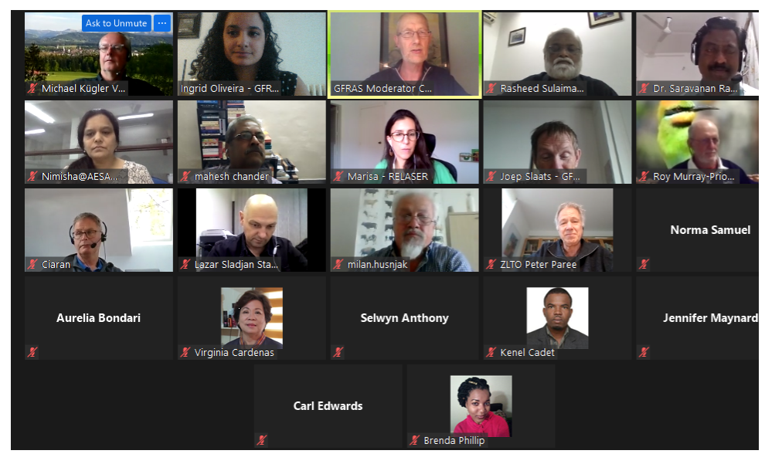
Synchronous e-extension tools
One-on-one phone call
Tele-conference call
Web meeting
Radio
Online polling

Slide 24
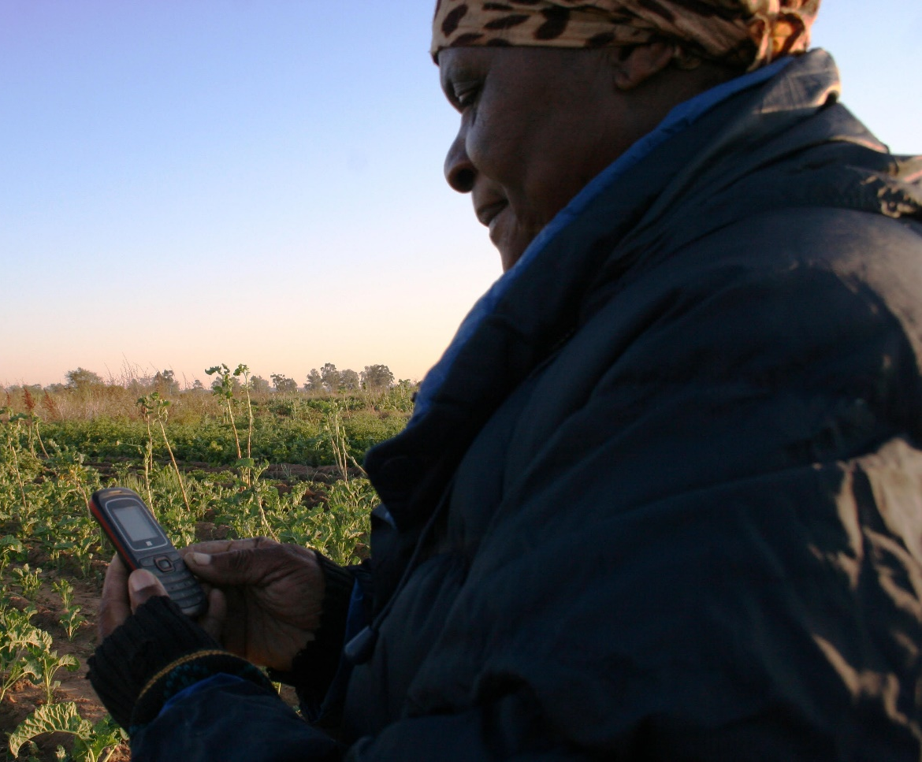
Asynchronous e-extension tools
Social media
Direct messaging
Mobile apps
Short videos
Podcasts
Blogs
Online document collaboration
e-Surveys
e-Bulletins

Slide 25
e-extension case studies and COVID-19 experiences
Study Unit 3

Slide 26
Overview
Study Unit 3 covers the following
Several real-life applications of e-extension, and how they were used to achieve the desired project outcomes
Different challenges and solutions that were used to overcome them
COVID-19 challenges and how the wise use of e-extension tools helped overcome them

Slide 27

Case studies
COVID-19 suddenly and dramatically changed how business is conducted. This unit illustrates various e-extension tools used by extension practitioners to continue their work.

Slide 28
Agricultural Information and Communication Programme (AICP) (Rwanda)
AICP is the main information channel for e-extension material and content.
The program uses already existing extension structures and developed content and avail them to the general public including farmers, private extension and value chain actors.
This is a government supported program that has all potentials to reach a wider audience

Slide 29
Strength, weakness, challenges and opportunities
Potential to reach a wider audience through channels and partners of the Ministry of Agriculture and animal resources (MINAGRI).
Uses different languages spoken in Rwanda including Kinyarwanda, French, English. Kinyarwanda is the main communication language.
Communicates the most updated information in crop production, livestock, market and weather information.
Farmers trust the information provided by the program, as it was certified and validated by the Ministry of Agriculture and animal resources.

Slide 30
Solutions
Communication platforms
Outcome
Call center (Toll free number: 4127)
Live and recorded radio and TV shows, radio drama and sketches,
Short videos,
Agriculture market information system,
Social media (Youtube, twitter, facebook, WhatsApp)
Web based extension platforms
Farmers can call the MINAGRI’s call center to ask information, report incidents and provide feedback to extension services.
The call center agents can call back or respond to farmers if the issue raised was not answered immediately.
MINAGRI gathers and shares daily market information through the e-soko system.

Slide 31
Constraints and lessons
The capacity of farmers to consume digital information
  Apart from radios, farmers do not have access to digital tools like smartphones, computers and internet that allows access to digital platforms.
Frontline extension agents must be empowered in digital literacy.
Most Rwandan farmers are old and their capacity to use digital tools and consume digitized information is very limited
  It is important to engage more youth in extension and advisory services provision.

Slide 32
Results
Radio was the most widely used channel of communication to disseminate agricultural messages.
Community-based radio stations played a great role in reaching out to community farmers in different parts of the country.
From July 2017-June 2018, 312 live radio talk shows were aired on many radio stations.
50 pre-recorded radio shows were aired on Radio Rwanda and rebroadcast on many stations.
109 digital green projectors were distributed in 8 districts as part of ‘ICT enabled for agricultural development in rural communities’ project.

Slide 33

Integrated Technology Enabled Agri-Management System (iTEAMS), Meghalaya State, India
1917 iTEAMS is a market-oriented e-extension programme that connects farmers to markets, and vice versa, through real time agro advisories. It uses cloud technology, affordable logistics and market information (www.1917iteams.in).
Notes:
iTEAMS logo from their Facebook page

Slide 34
e-Extension application
All the calls made to iTEAMS go to an IVR system through a 32 primary rate interface (PRI) line system.Callers are routed to different incoming call officials (ICO) based on their reason for calling.
Those who need an agri-response vehicle (ARV) are diverted to the vehicle despatch team. Those who need advisories are routed to an ICO level 1 expert. If the query is not resolved by the L1 expert, it is sent to a level 2 domain expert for resolution.
The ARV operations are tracked by a GPS system and vehicle tracking software developed locally, which keeps a tab on the trips, distance, time and location of the vehicles.

Slide 35
Solutions
Agro Advisory: Provide farmers with timely and accurate information for to help them make good decisions. Farmers can call the toll free number (1917) for any queries on agriculture, horticulture, fisheries, animal husbandry, apiculture, and sericulture.
Logistics Solutions: Provide farm produce transportation logistics solutions to farmers and buyers who want to transport their goods to any farms or markets of their choice.
Market Connection: Provide information about potential markets and sellers, and make farmers and buyers aware of the different selling/buying options available to them.

Slide 36
Constraints and lessons
Constraints
Lessons
Creating awareness among the farmers about the services
Registering and collecting farmers’ data
Ensuring multi-stakeholder partnership
Addressing rural connectivity and language issues
Updating the knowledge management system continuously
Integrating both agri-advisory and market linkage are crucial
Logistics support is essential for transporting farm produce
Entrepreneurs and agri-business firms’ partnership is essential to ensure better market prices for farmers
More on this case study: https://www.aesanetwork.org/wp-content/uploads/2020/04/AESA-COVID-19-FIELD-NOTES-1-.pdf

Slide 37
Farm Radio International, Africa
e-extension tool: Radio
Broadcasting relevant information and creating awareness among the community members.
For women farmers, radio on demand approaches may be effective, as they can choose when to listen to the programmes each week through pre-recorded mp3 versions delivered to women’s groups.
For women farmers, radio on demand approaches may be effective, as they can choose when to listen to the programmes each week through pre-recorded mp3 versions delivered to women’s groups.

Slide 38
Advantages
Accessible to all: Broadcast in local languages that everyone can understand and radio reaches everyone.
Convenient to use: Plentiful and portable. People can listen while they do other tasks.
Inexpensive: Affordable for listeners and broadcasters to share important information with a large audience.
Nimble: Immediate and can deliver information quickly, which is especially useful in emergency situations.
Interactive: When combined with devices like cell phones, listeners can ask questions, provide feedback and amplify their voices over the airwaves.
High adoption rate: Forty percent (40%) of farmers who learn about a new practice through a radio program apply it on their farm.
Less expensive cost information dissemination: Costs about 50 cents to provide one of these programs to a farming family.

Slide 39

COVID-19 response by the Farm Radio International

Slide 40
COVID-19 response by the Farm Radio International
Uses trusted sources of information to create awareness among the community members
Developing broadcasting guidelines to support other broadcasters during the emergencies and also to support communities.
Combating fake news about COVID-19 through community connections and moderating WhatsApp groups of the broadcasters from 12 countries.
Questions related to COVID-19 are answered regularly.
Broadcasting regular programmes for the benefit of community members.
https://farmradio.org/
https://farmradio.org/our-work-on-covid-19-so-far/
https://farmradio.org/supporting-radio-journalism-during-covid-19/

Slide 41

YEAN Farmer Platform, Rwanda
Created and hosted by Youth Engagement in Agriculture Network (YEAN)
Farmers receive information and tips being shared by experts on various platforms.
Farmers discuss topics, questions and inputs provided to exchange knowledge and learn from their peers.

Slide 42
e-Extension application
Farmers join platforms created on WhatsApp and Facebook to receive information and tips being shared by experts on those platforms.
In addition, farmers discuss with each other about posted topics, questions and inputs provided to exchange knowledge and learn from their peers.
This platform brings together experts from different organizations that work in agriculture and farmers.
Joining the platform is free provided that you have access to the internet either on your computer or smartphone.

Slide 43
Advantages and disadvantages
Advantages
Disadvantages
Using internet and smartphones to get accurate and timely information
Easy to ask a question on the platform and receive hundreds of responses
Not every farmer or extension agent has access to digital tools, especially rural farmers and some frontline extension agents

Slide 44
Solutions
The use of digital tools will increase in rural areas due to increasing government focus on a digital agenda.
WhatsApp:
  WhatsApp has recently gained popularity among farmers given its effectiveness in delivering the message to a wider range of people in a group.
Facebook
  The YEAN Facebook Farmer Platform has reached 18,000 farmers on Facebook in March 2021. Anyone can publish a post but it has to be approved by one of the admins to avoid inappropriate content.

Slide 45
UPTAKE Project, Tanzania
e-extension tool: Short Messaging Service (SMS)
The project aims to reach at least 1 000 000 smallholder farmers (with 3 ha or less) and facilitate the adoption of good practices by 150 000 farmers. At least 40% of the targeted farmers are women. Inclusion is promoted by deliberately seeking out women during the registration process.
UPTAKE provides a platform to increase awareness and adoption of improved maize varieties, developed under the Scaling Seeds Technologies Partnership (SSTP) for the southern highlands of Tanzania.

Slide 46
Opportunities
Bring together all stakeholders to agree on techniques to be promoted.
Ensure that high yielding maize varieties are bred, commercially bulked and released to ensure market availability.
Enhance link between research institution and private companies promoting four seed varieties.
SSTP worked with private and public sector partners to transform agriculture in Tanzania by promoting technologies to improve production. Maize is one of SSTP’s target crops, because of its important contribution to livelihoods of both subsistence and commercial farmers

Slide 47
Solutions (initiatives/ innovations)
UPTAKE introduced an SMS service through a private mobile valued added services provider (mVAS) Esoko, to provide farmers with quality information to:
Enhance maize production,
Reduce farmer exposure to risks, and
Minimize post-harvest losses.
Farmers received information on maize varieties adapted to their geographical areas.
Farmers learnt the benefits of using improved seeds, how to identify genuine seeds and where to buy them.
Farmers learnt about good agricultural practices covering the entire cropping cycle.

Slide 48
Lessons
The effort to bring more female farmers on board should take into account low literacy levels and women’s decision-making roles in farming.
Backstopping visits should be organized and collaboration with extension agents should be increased to guide on cropping schedules.
SMS delivery to the farmer needs to be separated according to agroecological zones.
The subject matter specialists need to ensure messages contain locally tested/agreed upon technologies according to the technology brief
Lessons from farmers, extension agents and the entire maize value chain are being collected and integrated.
Some of the lessons relate to the type of information that farmers find constructive and easy to implement.
Other lessons relate to how to better engage women to participate in the campaign.

Slide 49
Khushaal Zamindar - Mobile agriculture service by Telenor Pakistan
e-extension tool: Mobile phone based value added service
Aims to improve yields and save farmers from disaster
Offers a three-layered value proposition to farmers:
  Improve yields,
  Save them from disaster, and
  Encourage greater social recognition.

Slide 50
Solutions
Users dial 7272, numbers chosen because they sound the same as the Urdu words meaning “work together”.
Content is delivered in the form of short conversations between members of a local farming family.
Daily outbound dialling (OBD) and SMS including weather forecasts and agricultural and livestock advisory are also available through IVR.

Slide 51
Key insights
Farmers are sociable and regularly discuss agricultural issues.
Middlemen play a key role in the ecosystem as investors.
Farmers expect a high level of understanding of their land, especially soil and water analysis.
Of farmers who used the service for a minimum of six months:
77% reported at least one on-farm change
42% reported changes to planting practices
20% reported changes to post-harvest and storage, and
53% of them reported increased income as a result.

Slide 52
Social Media - WhatsApp, Kerala, India
e-extension tool: WhatsApp
Purpose: WhatsApp to link the vegetable producers to markets in Kerala
The Kerala State Department of Agriculture Development and Farmers’ Welfare (DADFW) is facilitating and financial support agency.
The NGOs also given financial assistance as per the project guidelines to take-up vegetable production in their institutional premises.

Slide 53

COVID19: Experiences
The vegetable production coincided with the national lockdown.
Group of farmers and NGOs cultivating vegetables were unable to reach markets to sell their produce.
This Photo by Unknown Author is licensed under CC BY-NC-ND
The government strengthened all the markets that were aided by the government, and started farmers’ retail outlets in all Krishi Bhavans (the office of the agricultural department at village level) with minimum arrangements so that farmers could sell their produce.
The existing markets were strengthened and 38 new Farmers’ Retail Outlets (FRO) were set up as Jeevani Sanjeevani Markets in the Krishi Bhavan premises. Even though all the markets started functioning, product movement did not happen as expected due to the lockdown

Slide 54

Solutions (initiatives/ innovations)
To facilitate marketing by connecting the producers and sellers, the agricultural officers created WhatsApp groups with
  Farmers,
  Buyers,
  Agricultural officers, and
  Officers from the marketing department.
Farmers started to post the availability of the vegetables with photographs and videos and buyers negotiated a price.
As the group, members were in different levels such as village to district level. Surplus vegetables could be sold in the other districts.
This Photo by Unknown Author is licensed under CC BY-SA-NC

Slide 55
Social Media: YouTube, India
e-extension tool: WhatsApp, Telegram and YouTube
Started as a WhatsApp group for livestock farmers in 2016
A Telegram group was started by shifting all the members from WhatsApp to Telegram in 2020.
The aim of the group is to share information related to first aid and management techniques in livestock farming.
The livestock owners in the group used to post their questions in the form of text, voice or video messages and the answers would be given to them by the experts in the group.
The audience (147 352) includes livestock owners – varying from small farmers to large farmers – entrepreneurs who were willing to start a new venture, veterinary graduates, veterinary assistant surgeons, scientists, and the general public.

Slide 56
Challenges
Getting responses and viewership
Creating farmers’ preferred content
Specific need based content
Recording and editing and uploading takes time
Regular responding and interacting with viewers
Increasing active users’ demands relevant and current of audience interest
Varied and farmer specific needs
Adding subtitles in another language
Adding search and user friendly elements

Slide 57

Benefit and Impact
When a YouTube video is liked, it will be shared by more viewers with their friends and peers.
Knowledge shared via YouTube has motivated new entrepreneurs to start a farm and some have already started their farms.
Worldwide impact, as many viewers from other countries were regularly seeing videos from the channel.
Notes:
CC Image

Slide 58
Lessons
Not easy to address comments from the general public, especially for the awareness videos posted on the channel, as they held lots of queries.
The platform creates awareness, shares knowledge with the audience, and helps the creator to update their professional knowledge.
An effective platform must be operated by specialized extension personnel who can communicate messages effectively every day by replying to audience comments and queries.
Integration is necessary, but requires a lot of time, dedication and commitment from the producer’s side to run the YouTube channel effectively.
The number of views per video was very few compared to the number of subscribers to the channel, which clearly indicated that people were interested only in the videos that answered their queries. They were not interested in looking into the channel for other videos unless there was a felt need. Subscription does not mean that every video will be watched.

Slide 59
Do’s
Upload videos based on the need of the audience
Use supporting images and videos
Make simple and effective content that is easy to understand
Regularly answer their comments and queries
Validated and practical information gives more credibility
Innovative delivery of content
Good description/title/thumbnail about the video

Slide 60
Don’ts
Supply false information/hopes
Include too much of theoretical content
Use fancy titles that do not match the content

Slide 61
COVID-19
To tackle the crisis faced by livestock farmers during Covid-19, a small group discussion was carried out on 3 April 2020 in the Telegram group to determine the constraints faced by participants.
It was then planned that the constraints could be addressed by creating awareness and providing the required clarity on the existing situation.
A question was posted on the group in the form of a video, asking what constraints were they were experiencing during the lockdown period, and whether they have any suggestions to mitigate them.

Slide 62
Lessons
Livestock owners are interested in YouTube Live programmes and sharing advice through social media.
The livestock owners are satisfied with the timely advisory services provided to them through social media.
The adoption of feeding practices recommended during the interactions and several farmers reported that they modified the feeding pattern based on the available feed and fodder.
Farmers realised the importance of saving the animal during this crisis more than sustaining milk production.
Many farmers received moral support while participating in the live programme.

Slide 63
Network for Information on Climate Exchange (NICE), India
e-extension tool: SMS and web based knowledge management platform
Purpose: To integrate climate adaptation and mitigation measures into the national and state development planning.
Stakeholders: The GIZ - Providing financial support and guidance, the National Institute of Agricultural Extension Management (MANAGE), providing agro-advice facilitation and support, DHAN Foundation.

Slide 64
Innovations
Initiatives
Impact
Awareness
Accessibility
Advancement
Queries & answers
Display boards
Voice SMS
WhatsApp groups
Video/audio conference
Focus group discussions
Among the farmers surveyed in Tamil Nadu, India, 40% reported that they were able to increase the yield of their crop marginally due to advisories provided through NICE platform.
Yield increase was reported mostly by farmers who adopted silt application.

Slide 65
Online Surveys: ICT4RAS interest group of GFRAS-Global Survey on Social Media
e-extension tool: Online survey using Google Forms’ Social media for agricultural extension and advisory service
A global survey was conducted for the ICT4RAS interest group of GFRAS globally among the extension practitioners and professionals.
Google Forms: Google Forms is a freeware online survey tool associated with Google Drive. It is used for creating web surveys, tests, or web input forms.

Slide 66
Advantages and disadvantages
Advantages
Disadvantages
A global audience was reached in very little time and at no cost at all
Data visualization was easier
Accessible through smartphones
Page breaks make the sections sequential and breaks monotony
Limited audience, as it is accessible only to those with internet access
Non-response
Dropping out because of compulsory questions of a sensitive nature
Limitations in designing the questionnaire

Slide 67
Do’s and Don'ts
Visualization of output before preparation of a schedule
Precise, clear and concise questions
Choice of online data collection tools should be based on the type of questions to be posed
Page breaks should be incorporated instead of long scrolling surveys
Sequence of questions should be logical
Mention tentative time required to take the survey
Leading questions should be avoided
If options are non-exhaustive, “other” option should be incorporated
Long questions need to be avoided
Privacy protection measures need special attention
Communication of survey results to respondents is necessary
Do’s and Don’ts when using Google Forms as a web survey tool:

Slide 68
Other e-Extension Initiatives for further understanding: Farmer Query System mPower Social Enterprises Ltd. Private Sector, Bangladesh
e-extension tool: SMS (Short Messaging Services), Voice Message, or via phone
Agricultural experts are providing demand-driven solution to farmers

Slide 69
Strength, weakness, challenges and opportunities
Agricultural information service has traditionally been provided to farmers for free. As a result, farmers do not expect to have to pay for agricultural advice.
In an effort to commercialize FQS and to make the service sustainable, they are looking to create a business model where they can cross-subsidize services to farmers from revenue earned elsewhere.

Slide 70
Solutions (initiatives/ innovations)
The agriculture expert reviews all the information on a web dashboard and sends recommendations and solutions to the infomediaries through a variety of digital channels.
1
Digital channels including SMS, voice message, or phone calls, which is passed on to the farmers in 3 - 6 hours.
2
Professional experts providing the service are no longer limited by geography and can reach many more farmers on a given day than in traditional circumstances.
3

Slide 71
Constraints and lessons
Rural farmers face a lot of challenges in their crop production and they usually seek advice from extension practitioners, and input retailers.
Restricted movement due to COVID 19 means these farmers cannot access their usual knowledge sources.
However, getting timely and specific information for their crop problems is crucial, otherwise, farmers are likely to make choices that will result in higher costs and even produce less than the expected amount of yield.

Slide 72

RegoPantes, 8villages Private Sector: Indonesia
e-extension tool: Smartphones, by giving the right incentive which is a marketplace for farmers and buyers
Indonesian farmers are the beneficiaries.
Can be used by various business lines to market business products without worrying about the involvement of middlemen or intermediaries.
Notes:
I would have made this image bigger, but it pixelated badly

Slide 73
Strengths and solutions
The project has already been running for three years.
Farmers receive better income and buyers receive fresh product directly from farmers.
Shopping for vegetables and fruit online is no longer a lifestyle, but has become a necessity.
The marketplace continues to try to be a marketplace between farmers and consumers and keep involved farmers in the value chain to reduce dependence on many parties.

Slide 74

Constraints and lessons
Constraints
The low demand from culinary businesses decreases farmers' incomes significantly.
Lessons
A digital market is needed to connect farmers directly to end consumers
More on this case study: http://8villages.com
http://regopantes.com

Slide 75

AgroRuqsat "Information and Account Centre" JSC Government, Kazakhstan
e-extension tool: Web technology and integration with government databases
Farmers affected by the COVID-19 outbreak are the stakeholders.
The AgroRuqsat electronic pass mechanism allows you to speed up the process of transport and farmers crossing the boundaries of quarantine zones.
To apply for a pass, you must register on the website www.qoldau.kz and login into your personal account, where the user identifies themself with a digital identification key.
Notes:
AgroRuqsat logo

Slide 76

Opportunities
During the quarantine outbreak in Kazakhstan, a state of emergency was declared and the government decided to prohibit movement across the borders of all villages, districts and regions.
Farmers, whose farm fields can be located in several districts and regions, encountered difficulties in sowing and field work due to difficulties in obtaining paper passes, which put Kazakhstan's food security at risk.
Therefore, it was necessary to implement the solution as quickly as possible so that the sowing took place at the right time.
Notes:
CC image

Slide 77

Solutions
AgroRuqsat is a free online service designed to address the issues of providing transportation permits for farmers and their suppliers in quarantine zones
It remotely receives applications for electronic passes, processes these applications, and maintains a register of electronic passes.
The pass is free and valid for the entire period of emergency and quarantine.
Within a few minutes to one business day, the applicant receives an electronic document granting the right to cross the roadblocks to proceed to their land plots.

Slide 78
Constraints and lessons
Constraints
Lessons
The implementation of the project has a tight timing.
The digitization level of the agricultural sector in some regions of the country is much lower.
A sudden outbreak of the virus required accelerated decision-making and implementation of the service
In case of errors or system failures, it is necessary to eliminate defects as quickly as possible so as not to interrupt the service, and thereby allow farmers to complete their field work on time.
More on this case study: http://iuc.kz
https://ruqsat.qoldau.kz/ru/information/

Slide 79

Zimba Women Zimba Mart, Uganda
e-extension tools: Several e-commerce digital tools
Zimba Mart focuses specifically on women.
There is no marketplace, physical or online that is specifically targeted at women merchants.
Women form the largest percentage of small scale suppliers of home, agricultural produce and clothing apparel.
Notes:
CC image

Slide 80
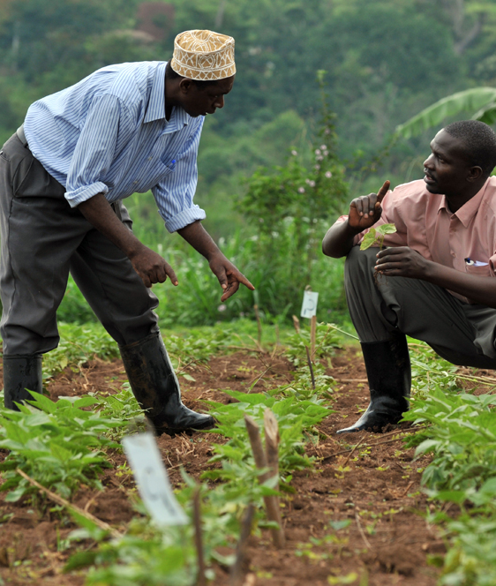
Strengths
This innovation has encouraged women trading online to enable the on boarded SMEs learn how e-commerce can enable business growth
Enables them to update their social and business pages to take advantage of the increased traffic to their sites due to the Zimba Mart
The Zimba Mart has also given women merchants more visibility as they have customers from not only Kampala, but from all around Uganda and even the USA.

Slide 81
Solutions (initiatives/ innovations)
In general, and during lock down, SMEs on-boarded on the Zimba Mart platform have benefited from adopting an e-commerce approach in a number of ways:
Lower transaction costs
Reduction in advertising and promotion costs
Rapid communication between buyers and sellers
Ability to reach new customers
Shorter supply chains
Eliminating physical limitations

Slide 82
Response to challenges
Identifying women-owned or women-led SMEs which have fundamentally sound value propositions but have been severely impacted by COVID-19.
Providing dedicated COVID-19 impact analysis and contingency planning to these SMEs through offering business training and digital literacy training via our online platforms.
Women-owned e-commerce platform to both adjust to the market dynamics created by COVID-19 lock down actions.
Provide remote support as well as follow-on support to the women-owners/leaders to enable them to protect their enterprises
More on this case study: https://www.zimbamart.com
https://www.zimbawomen.org/

Slide 83
E-KOKARI Interactive Voice Response (IVR) platform, Niger
e-extension tools: Interactive Voice Response (IVR) Platform for Agriculture, Livestock, Market Information to farmers, breeders and buyers
Several people have been involved in the process of the development of E-KOKARI and its testing.
NOVATECH is a small start-up in Niger that developed the E-KOKARI platform with the financial support of the World Bank, the Ministry of Agriculture and the Niger ICT High Commissary.

Slide 84

Strengths
Uses any type of mobile phone (smartphone or normal mobile phone)
The voice system makes information available in local languages to farmers who cannot read or speak French.
Producers can use their phone to access voice recorder information in their own language, which will facilitate the uptake of improved agricultural techniques.
The farmers trust the information provided by the platform.
Notes:
CC image

Slide 85
Solutions (initiatives/ innovations)
E-KOKARI, developed in Niger allows farmers, breeders and buyers to access information, advice, warnings and market prices in the field of agriculture and livestock.
When a user dials a short from their phone, they can access a voice menu in the main local languages (French, Hausa and Zarma), which guides them according to their needs.
A prototype was developed and tested over a period of 10 years.

Slide 86
Constraints and lessons
Constraints
Lessons
Training farmers how to use the platform
Most mobile phone owners and users only use their phones to make calls.
Absence of sufficient equipment to scale up the prototype in collaboration with the mobile operators in Niger.
This is a new way of accessing information for most users, there is a need to foresee enough time for capacity development
The rural population is able to charge their phones using solar power if there is no electricity.
More on this case study: http://www.fao.org/3/BU743EN/bu743en.pdf
https://www.do4africa.org/en/projects/smart-economy/8354/e-kokari-4/

Slide 87
Concluding thoughts
Study Unit 4

Slide 88
Overview
Study Unit 4 covers the following
Mindset required for success
Importance of frequent practice
Ways of successfully using a community of practice
Importance of being brave

Slide 89
Best-fit functions and conditions
It is easy to be distracted or overwhelmed by the wide range of e-extension tools available
It is important to focus on the farmers in your target audience, and determine what is best going to meet their needs.
Because of their diversity in age, gender, education, experience and so on, a single approach will not be effective for everyone.

Slide 90

Steps for e-extension success
Mindset
Practice
Community of practice
Practice
Be brave

Slide 91
Concluding remarks
e-extension has been used in different situations in different countries around the world.
Numerous examples were provided to give you insight into how COVID-19 has affected the wellbeing of communities and changed the way you can engage with your target audience

Slide 92
Acknowledgements
Lead authors: John James and Saravanan Raj
Coordinating team: Carl Erik Schou Larsen, Hlamalani Ngwenya, Joep Slaat and Ingrid Oliveira
Advisory Group: Jeff Mutimba, Ben Addom, Andrianjafy Rasoanidrainy, Tawanda Hove, Florian Herzog, Claudia PatriciaToro Ramirez, Francisco Aguerra, Tessa Barry and Jenealle Joseph.
Financial support: This module was made possible through the support of the Swiss Development Confederation (SDC). The contents of this module are the responsibility of the authors and do not necessarily reflect the views of Swiss Government

Slide 93


Acknowledgements
This module was made possible through the support of the Deutsche Gesellschaft für Internationale Zusammenarbeit (GIZ) and United States Agency for International Development (USAID).
The contents of this module are the responsibility of the authors and do not necessarily reflect the views of GIZ and USAID or respective their governments.
All work by Global Forum for Rural Advisory Services is licensed under a CC BY-NC 3.0 Unported License.

