Slide 1
Nutrition-sensitive extension
Global Forum for Rural Advisory Services (GFRAS)
Part of the New Extensionist Learning Kit

Slide 2
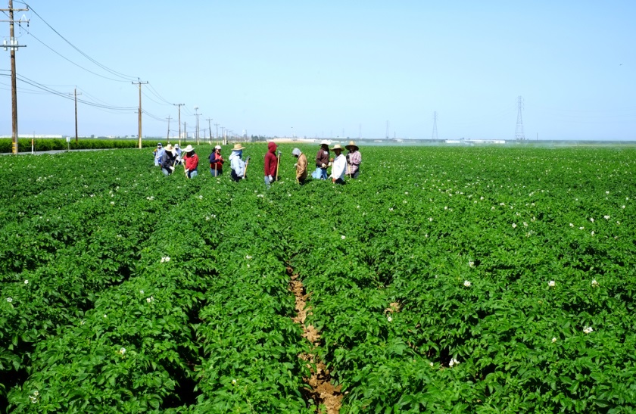
Agriculture and nutrition
Malnutrition is a big problem world wide
  Can have a negative impact on the agriculture and economy of a country
It has been estimated that better nutrition could improve the GDP of many countries
Notes:
Every country on the earth is affected by poor nutrition, and the results of poor nutrition affect most families. Since agriculture produces food, it is the foundation for nutrition.
This presentation will cover the basics of a nutritious diet and the results of poor nutrition, ways that agriculture and nutrition impact each other and what extensionists can change in order to improve nutrition.

Slide 3
What is nutrition?
Study Unit 1

Slide 4
Overview
Study unit 1 is about:
Micronutrients and macronutrients
The food groups
Food-based dietary guidelines and food guides
Nutritional status indicators
Factors that affect food choices
Helping people make better food choices

Slide 5
The basics of nutrition
Nutrition is the study of:
  what happens to nutrients in the body
  how people can get the right types of food for good health and growth
For your body to function you need to eat a healthy diet, which is a diet that:
  meets a person’s daily nutritional requirements
  has the correct balance of macronutrients and micronutrients
Notes:
Nutrients: Substances that are needed for healthy growth, development and functioning, usually found in the food a person eats.

Slide 6
Micronutrients
Vitamins, minerals
Needed in smaller amounts to maintain a healthy body
Macronutrients
Carbohydrates, proteins, fats and oils
Provide energy
Measured in calories or kilojoules
Needed in larger amounts to support normal body functions and health

Slide 7

Macronutrients
Carbohydrates
  provide energy for the body to move, breathe and perform daily activities
  E.g. rice, porridge, cassava and sweet potatoes
Proteins
  help build muscles and repair wounds
  E.g. beef, fish, cowpeas and lentils
Fats & Oils
  provide energy, support brain function and
  protect organs
  E.g. butter, vegetable oil, nuts and seeds

Slide 8
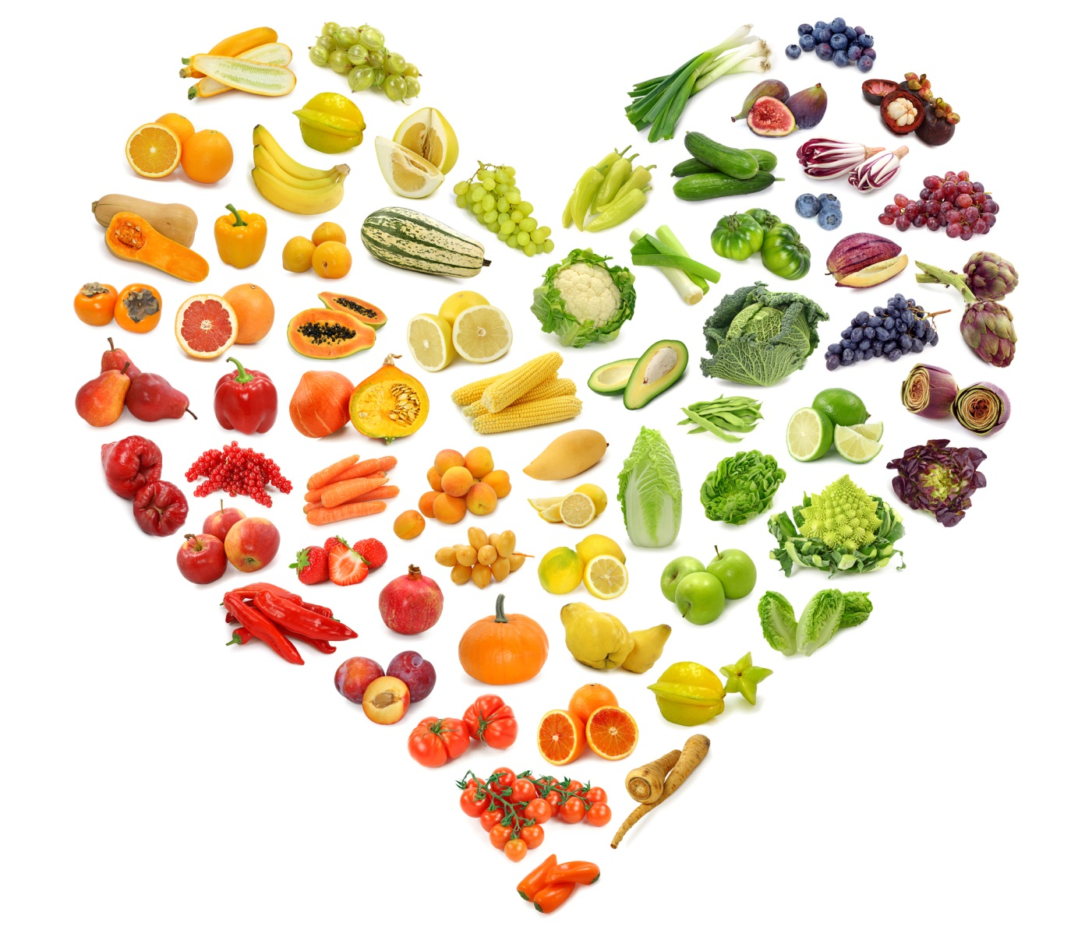
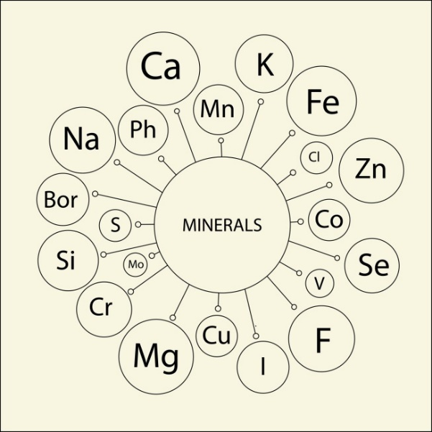
Micronutrients
Vitamins
  support the immune system, help the body grow and break down food into energy
Minerals
  support bone growth and proper nerve function and they help regulate heartbeat
Notes:
Vitamins include Vitamin C which help repair and maintain healthy bones and teeth. Vitamin C can be found in bell peppers, dark leafy greens, papaya and tomatoes. Vitamin A helps with eyesight and reduces illness and can be found in carrots, squash, dark leafy greens and animal liver.
Minerals include Iron and Zinc. Iron helps provide oxygen to cells and reduces illness. It is found in red meats and animal liver, fortified cereals, chickpeas and lentils. Zinc helps with growth and brain development and reduces illness. It is found in beef, lentils, shrimp and edible seeds.

Slide 9
Food groups
A balanced healthy diet includes a variety of food from the different food groups
Food groups
  a collection of foods that share similar nutritional properties or nutrients they supply
Dietary guidelines divide food into food groups and recommend daily servings of each
Notes:
A food group is a collection of foods that share similar nutritional properties or biological classifications. Food guides typically divide foods into food groups and recommend daily servings of each group for a healthy diet

Slide 10
Food group | Examples | Importance
Staples | Maize, bread, tortilla, rice, porridge | Provides energy for the body to move, breathe and perform daily activities (cook, work in the fields, etc.).
Fats | Vegetable oil, butter | Provides the body with energy and protects the organs (heart, liver, skin).
Fruits | Papayas, mangoes, bananas, avocados | Helps protect the body from diseases and illnesses.
Vegetables | Pumpkins, potatoes, leafy greens, tomatoes | Helps protect the body from diseases and illnesses
Legumes | Cowpeas, kidney beans, lima beans, black beans | Helps strengthen the muscles, repairs wounds and protects against heart disease and diabetes
Meat and eggs | Chicken, beef, mutton, organ meats, eggs | Helps strengthen the muscles and repairs wounds
Dairy | Milk, yoghurt, cheese | Helps strengthen bones
Credit: Dr. Jeanette Andrade

Slide 11
Food-based dietary guidelines
Provide science-based recommendations about the quantity, quality and diversity of foods that should be consumed
Depend on a person’s size, activity level and factors that make some people require more nutrients than others
Different countries have developed food-based dietary guidelines that reflect the foods that are locally available and culturally preferred

Slide 12
Food guides
Visual representation of dietary guidelines and accompany food-based dietary guidelines
Include fewer specific recommendations
Make it easier for non-nutritionists to understand the quality, quantity and diversity of foods that make up a healthy diet

Slide 13
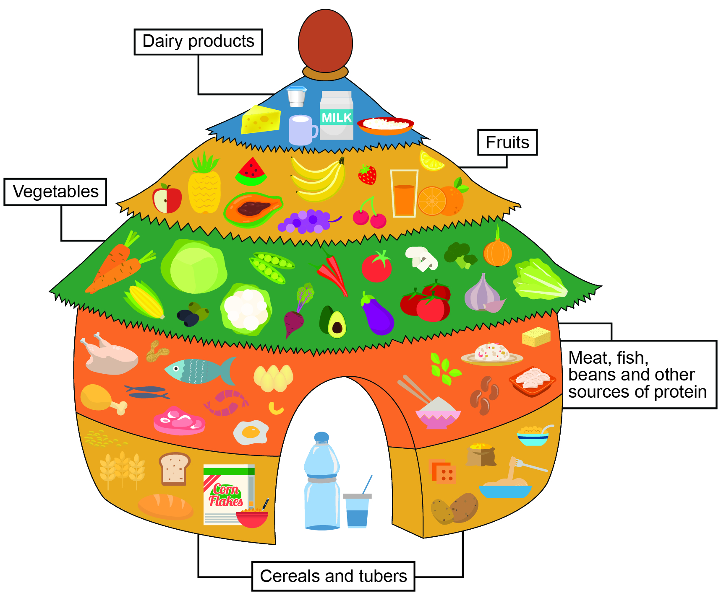
Notes:
Benin’s Food Guide displays five food groups in the image of a traditional round house with a thatched roof. Food groups that should be consumed in greater quantities make up the foundation of the house, while those foods that are needed in smaller quantities are shown in the smaller, higher tiers of the picture, like the roof.

Slide 14
Nutritional needs
People and animals at different stages of their lives have different dietary needs
Nutritional needs are determined by:
  Age
  Body make-up and size
  Activity level
  Physical state
Dietary needs also depends on an individuals nutritional status

Slide 15
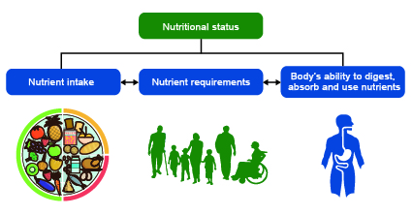
Nutritional status
Notes:
Nutritional status is the physical state of a person that is a result of the relationship between how many nutrients that individual takes in, their nutritional requirements and the body’s ability to digest, absorb and use these nutrients.

Slide 16
Nutritional status indicators
Used to assess the nutritional status of a person
Point out malnutrition
Involves measuring a person's height and weight, and comparing these measurements with what is normal or acceptable for their sex and age

Slide 17
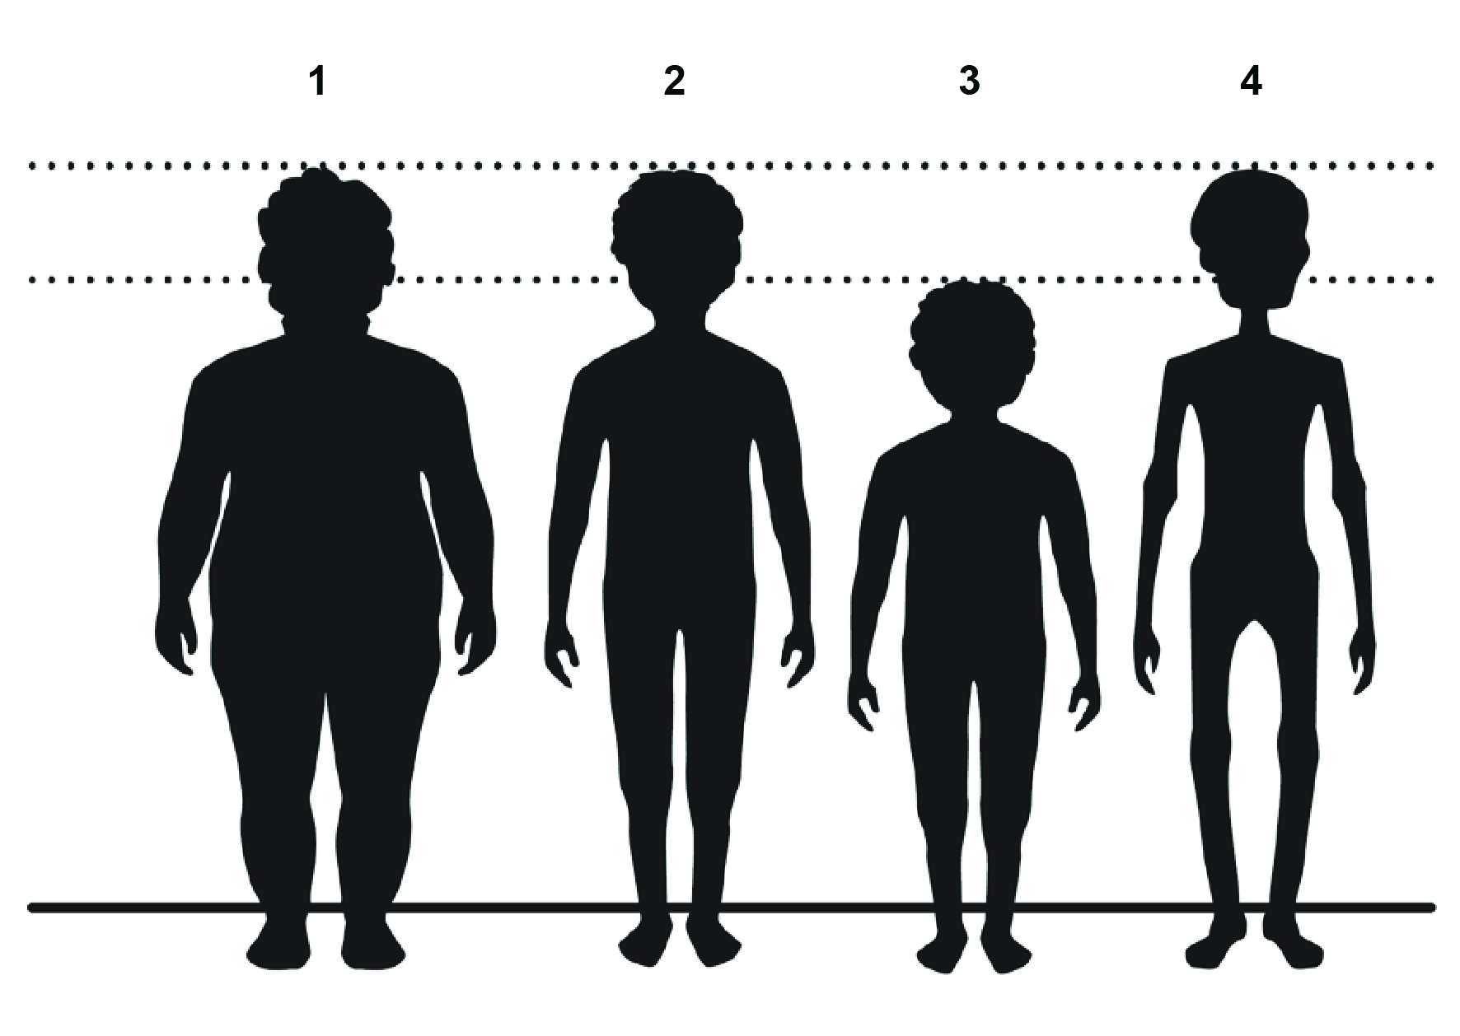
Nutritional status indicators
Overweight
Normal weight
Underweight
Obese
Stunting
Wasting
Notes:
Underweight: Weighing less than the normal amount for one's age, height and build.
Overweight: Weighing more than the normal amount for one’s age, height and build.
Obese: A more severe form of overweight.
Wasting: A form of acute malnutrition characterised by sudden, drastic weight loss caused by inadequate dietary intake.
Stunting: Impaired growth development caused by long term malnutrition.

Slide 18
Micronutrient malnutrition
A moderate to severe lack of one or more important micronutrients
Typically less visible and affects many people around the world
  E.g. Anaemia, Vitamin deficiencies
Under-consumption of nutrient-rich fruits and vegetables contributes to micronutrient malnutrition

Slide 19
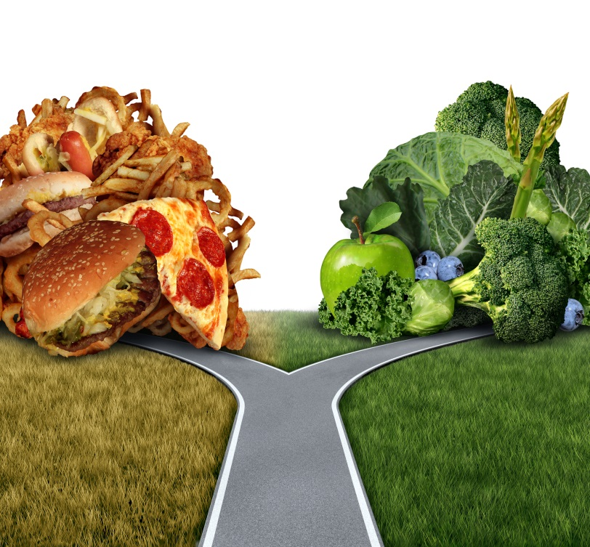
Making better food choices
There are several methods for influencing people’s food choices:
  nutrition education
  social and behaviour change communication
  social marketing
People will be more likely to change their food behaviours:
  when they are supported by their social networks
  when they have greater agency
Notes:
Agency: The ability to act independently and make their own choices

Slide 20
Factors that affect food choices
Food availability
Accessibility
Affordability
Desirability
Convenience
The price of food is a very important factor for food choice, especially in poor and subsistence communities
Social and cultural backgrounds play an important role in what food a person will want to eat or not
If a certain type of food is not easy to get or difficult to prepare, most people will rather choose a convenient alternative
Most people tend to choose food that is easy to get at a manageable distance from their home or work
Many people will only choose food that is already available in their local markets
Notes:
A person’s food choices are influenced by a combination of the physical, socio-cultural, political and economic surroundings and conditions that shape a person’s food preferences and choices.

Slide 21
Making better food choices
Tips that will help you to change unhealthy food habits in your community:
Use simple language
Focus on short- term benefits
Give only the essential information
Talk in a natural and friendly tone
Always treat people with respect
Always check whether your audience has understood your message
Notes:
Through nutrition education, agricultural extension agents can influence food choices at a personal level.
The communities where you will work may have low levels of education and be unfamiliar with complicated nutritional terminology. It is important that you know your audience well and adapt your explanations to different audiences.

Slide 22
Ways that agriculture can impact nutrition
Study Unit 2

Slide 23
Overview
Study unit 2 is about:
Understanding food systems
The functions of food systems
Agriculture-nutrition pathways
Women’s role in nutrition

Slide 24
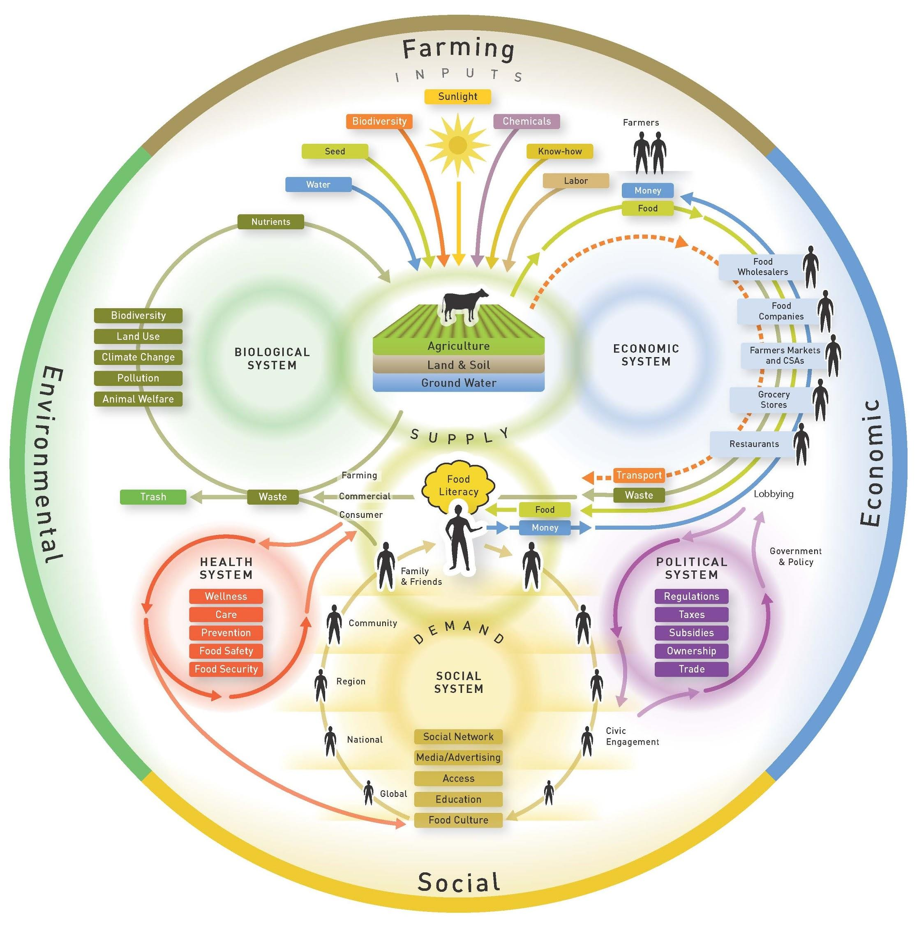
Food systems
A food system is the people, institutions and processes by which agricultural products are produced, processed and brought to consumers
Notes:
Food systems include a wide range of activities that make sure that the food that farmers produce reaches consumers

Slide 25
Food systems
Food systems will vary significantly between societies, cultures and countries
Eating a healthy diet depends on a food system where:
  Enough food is available
  Food is easily accessible
  The price of food is reasonable
  Food is safe and acceptable
Notes:
Because food systems determine the availability, accessibility, affordability and desirability of foods, they directly affect diet quality or the diversity, quantity and safety of the foods people eat. The quality of a person’s diet affects their nutritional status.

Slide 26
Functions of food systems
Food production
Food handling, storage and processing
Consumer demand, food preparation and preferences
Markets and trade
Notes:
It is important to understand how the food system functions in any given location.
These components influence a household’s choices about the food that they grow, purchase and consume.

Slide 27
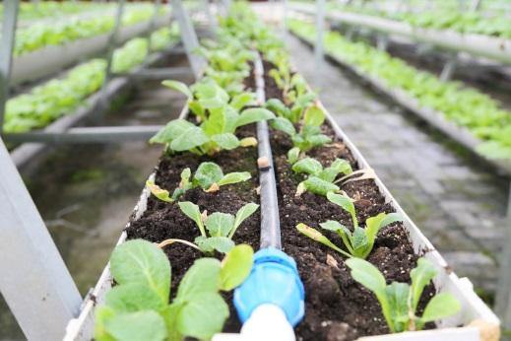
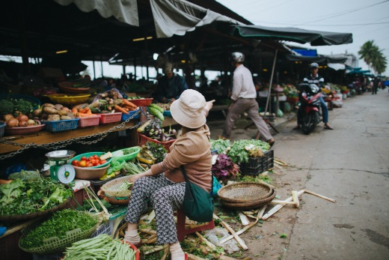
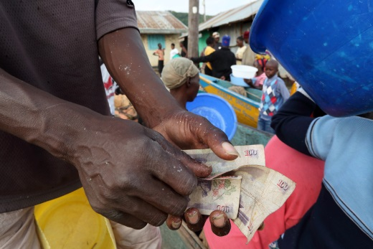
Impact of food systems
Food production
Determines how available and diverse food is
Farmers who use good agricultural practices can:
  produce safe, nutritious food
  while protecting natural resources

Slide 28
Impact of food systems
Food handling, storage & processing
Helps to preserve the quality of food, limit food losses, supports stable food supply and prices
Proper handling, storage and processing of food can affect:
  Shelf-life
  Safety
  Nutrient content
  Taste

Slide 29
Impact of food systems
Markets & trade
Makes diverse food more accessible
Good transportation networks within countries and across borders take products from the farm to the consumer

Slide 30
Impact of food systems
Consumer demand, food preparation & preferences
Drives decisions on the foods that are produced, processed and traded in markets
Sometimes based on cultural beliefs and gender norms

Slide 31
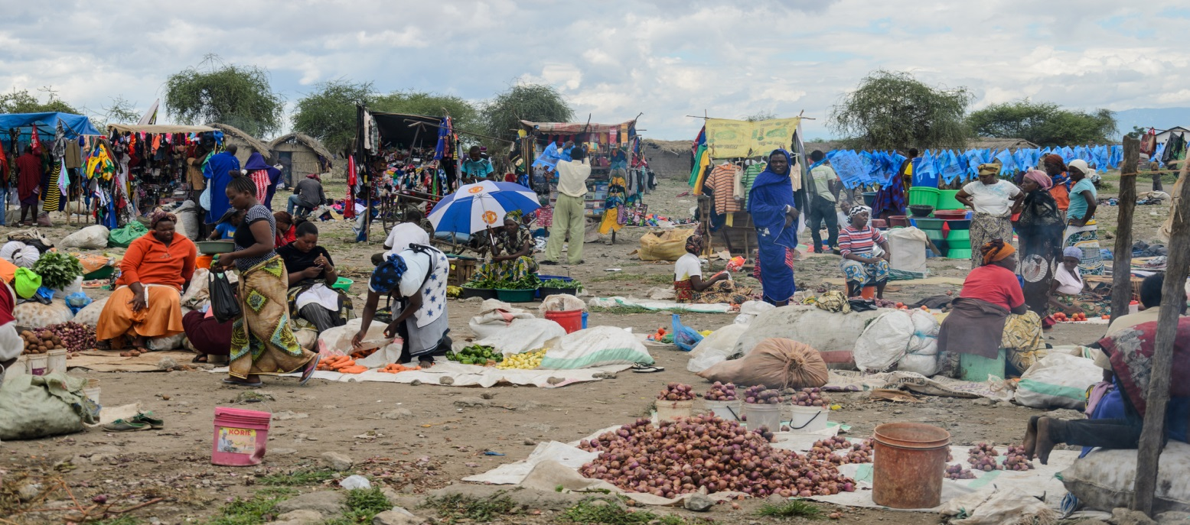
Agriculture-nutrition pathways
Agriculture-nutrition pathways visually represent how agriculture can impact nutrition

Slide 32
Agriculture-nutrition pathways
Agriculture-nutrition pathways
  Help planners develop projects that will improved nutrition
  Help monitor and evaluate change
Three major pathways
  Food production pathway
  Agriculture income pathway
  Woman’s empowerment

Slide 33
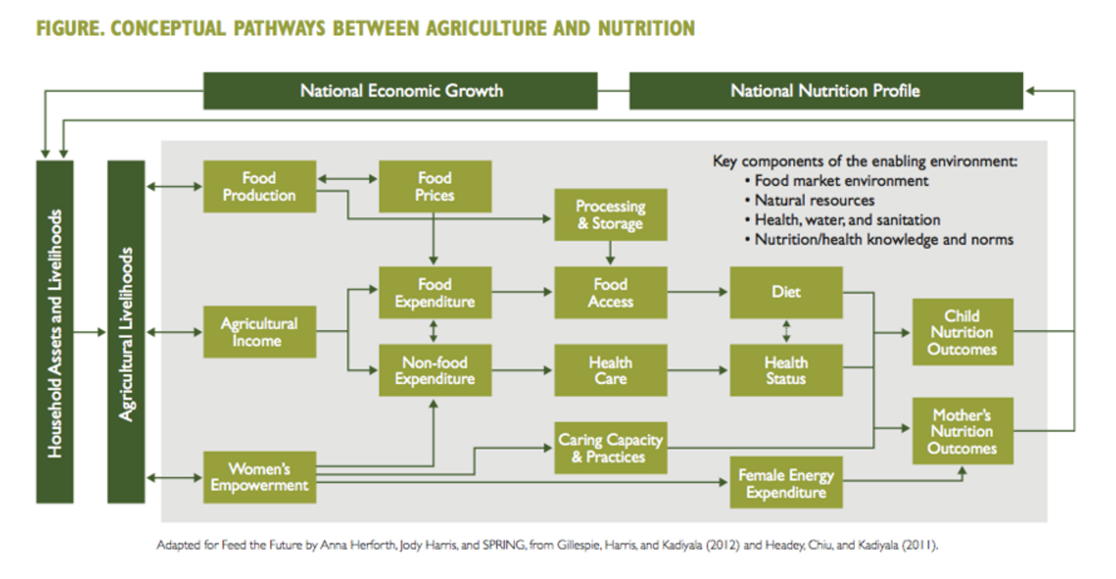
Agriculture-nutrition pathways
Notes:
These pathways help us think about how the actions of extensionists can affect nutrition.
The food production and agricultural income pathways were addressed in the section about food systems.

Slide 34
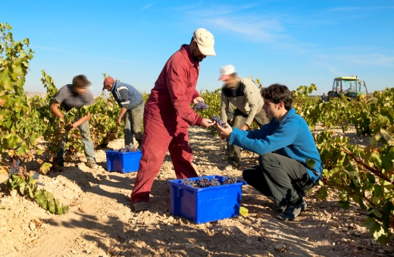
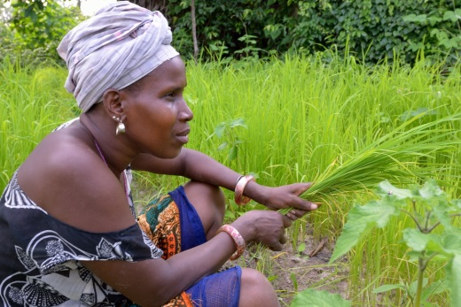
Food production pathway
Drives consumption, income and local food availability
Food production affects:
  Diversity and quantity of food available to farming households
  Food prices at local markets

Slide 35
Agriculture income pathway
Can be used for food and non-food purchases
Reliable and sustainable income helps rural households buy
  Nutritious and stable diets
  Better health care
  Education

Slide 36
Women’s empowerment
Important way to improve nutritional status through agricultural
Often overlooked pathway
Women who are empowered have:
  More decision-making power
  Better access to, and control over, resources
  More control over time and labour allocation
Notes:
Extensionists can support women’s empowerment by providing advisory services that meet the specific needs of men and women farmers.

Slide 37
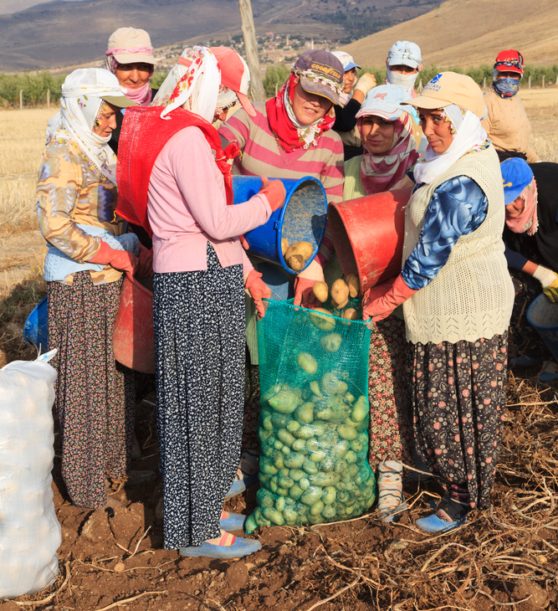
Women’s role in nutrition
Women play a central role in household care and nutrition
Women usually use additional cash income for nutritious foods and health care needs
When women and men make household agricultural decisions together
  Labour, income, gender equality and household nutrition greatly improve

Slide 38
Actions that extensionists can take to improve nutrition
Study Unit 3

Slide 39
Overview
Study unit 3 is about:
Nutrition sensitive agriculture
Nutrition sensitive rural advisory services

Slide 40
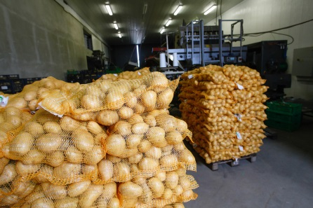
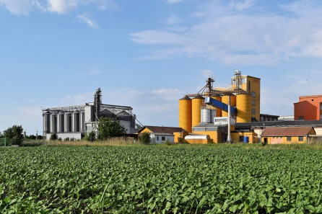
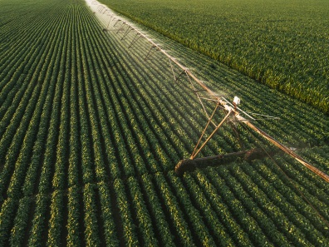
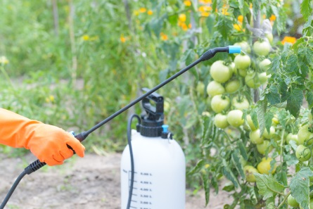
Nutrition-sensitive agriculture
Seeks to maximise agriculture's contribution to nutrition
Nutrition-sensitive agriculture focuses on
  Production of a variety of affordable, nutritious, culturally appropriate and safe foods
  In enough quantities and quality to meet the nutritional needs of a community
  In an environmentally sustainable manner
Notes:
Nutrition-sensitive agriculture is an approach that seeks to maximise agriculture's contribution to nutrition by focusing on the production of nutritious foods, and entails targeting poor households, promoting gender equality, and providing nutrition education so that household resources are used to improve household members’ nutrition, especially that of women and young children.

Slide 41
Nutrition-sensitive actions
Does the action increase availability of, and access to, diverse food?
Does the action increase households’ resources for accessing healthcare and nutritious foods?
Notes:
One way to consider if an agricultural practice is nutrition-sensitive is to ask these questions.
If you can answer “yes” to one or both of these questions, the agricultural practice likely supports healthier diets and good nutrition.

Slide 42
Nutrition-sensitive RAS
Increase production of more diverse and nutritious foods that people do not eat enough of and that address local nutrient deficiencies
Promote safe processing, preservation and storage practices and technologies both on the farm and across the value chain
Protect natural resources through good agricultural practices by adopting production systems that restore biodiversity and grow soil nutrients
Promote clean environments through good sanitation and hygiene practices, particularly related to handling manure, pesticides and fertilisers
Notes:
The following are some examples of nutrition-sensitive actions that relate to typical RAS duties. As an extensionist, you must aim to implement some of these actions.

Slide 43
Nutrition-sensitive RAS
Provide engaging nutrition education to encourage people to grow and eat healthy foods
Expand markets for nutritious foods and market access for vulnerable groups
Work across the value chain to increase the demand for and supply of healthy foods and to improve the nutritional value of food
Empower women in agriculture by ensuring their access to income opportunities, social networks and financial services
Notes:
The following are some examples of nutrition-sensitive actions that relate to typical RAS duties. As an extensionist, you must aim to implement some of these actions.

Slide 44
Establishing partnerships for better nutrition
Study Unit 4

Slide 45
Overview
Study unit 4 is about:
Partnerships and collaborations
Successful negotiation skills
Committing to action

Slide 46
Partnership & Collaborations
Many different organisations interact with farming households
  Extension services, governmental, non-governmental and civil society organisations, financial institutions, government officials and business people
When the actions of different sectors are coordinated, they can have more impact than when organisations are not familiar with each other’s work

Slide 47
Partnership & Collaborations
Challenges for collaboration
  It can be hard to find time to meet with partners from different sectors
  Coordination isn’t part of your assigned duties
  The language one sector uses to describe problems and solutions are unfamiliar to people from another sector

Slide 48
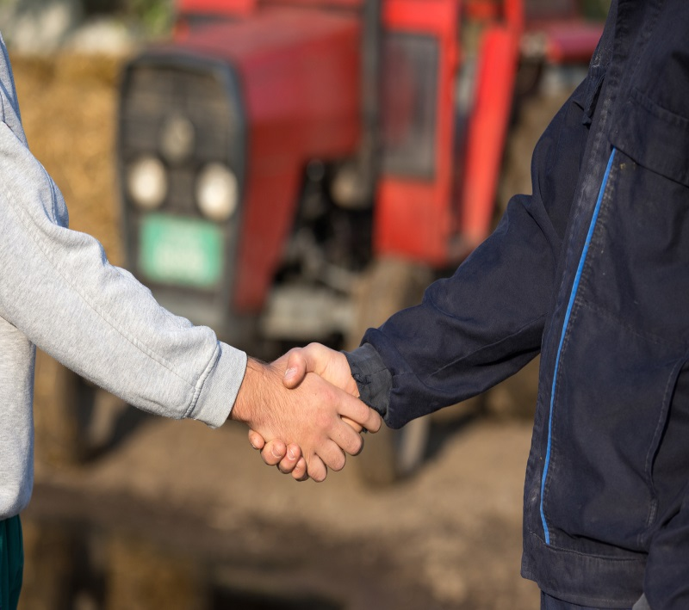
Successful negotiation skills
Effective negotiation skills can improve good and bad relationships
Negotiating requires that you clearly communicate your needs and listening respectfully to others’ needs
Notes:
It is important for you to work with these various entities so that community members can benefit from everyone’s interventions but not be overwhelmed by them. Effective collaborations also allow you to focus on your job without having to do tasks that another group is better able to do.

Slide 49
Basics of negotiation
Clearly state what you need and what you feel the communities need
Listen to and understand the needs of the potential partner or collaborator

Slide 50
Basics of negotiation
Use repetition to stay closely focused on your needs and the needs of communities and don’t get side-tracked
Finalise the agreement only when you are sure it will enable you and the communities to get what they really need

Slide 51
Committing to action
Extension professionals can contribute to better nutrition in many different ways
To help yourself identify and carry out the first steps to improve nutrition, answer the following questions:
  Which of your current activities already contributes to nutrition?
  Which activities could be shifted slightly so that they contribute more to nutrition?
  Are there activities that may be impeding nutrition?
Notes:
As an extension professional, you have learned how to support farmers to take steps to adopt new technologies and practices. Now you have to act on some of the information and skills that you have acquired while working through this training.

Slide 52


Acknowledgements
This module was made possible through the support of the Deutsche Gesellschaft für Internationale Zusammenarbeit (GIZ) and United States Agency for International Development (USAID).
The contents of this module are the responsibility of the authors and do not necessarily reflect the views of GIZ and USAID or respective their governments.
All work by Global Forum for Rural Advisory Services is licensed under a CC BY-NC 3.0 Unported License.

