Slide 1
Extension and value chains
Global Forum for Rural Advisory Services (GFRAS)
Part of the New Extensionist Learning Kit

Slide 2
The agricultural market, value chain and key actors
Study Unit 1

Slide 3
Overview
Study unit 1 is about:
  Agricultural marketing, the market and the value chain.
  Supply and demand and the effect on the market.
  Formal and informal markets.
  Key actors in the agricultural value chain.
  Key business development service providers.
  Key regulators in the agricultural value chain.
  Food issues and standards in the agricultural market.

Slide 4
Marketing
The process of identifying, anticipating and satisfying customer requirements profitably; i.e.
The right product.
The right place.
The right price.
The right time.

Slide 5
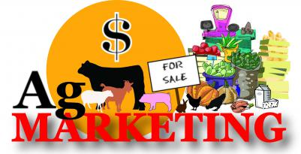
Agricultural marketing
Set of business activities that are performed in the flow of products from the beginning of agricultural production into the hands of consumers.

Slide 6
Agricultural marketing elements
The customer.
Factors that can be controlled, known as the marketing mix, are product, price, place (distribution) and promotion.
Environmental factors, which cannot be controlled, are political, economic, legal and technological factors.
All activities and services from the farmer to the consumer.

Slide 7
Agricultural marketing elements
Production planning.
Growing and harvesting.
Cleaning, grading and packaging.
Storage and transport.
Distribution.
Advertising.
Sales.

Slide 8
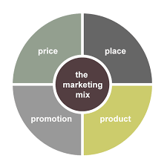
The marketing mix
A set of tactics and strategies that a company (or farmer organisation) uses to promote its product in a particular market and that is made up of the so-called 4Ps of marketing: product, price, place and promotion.

Slide 9
Agricultural marketing activities
Production planning.
Growing and harvesting.
Cleaning, grading and packaging.
Storage and transport.
Distribution.
Advertising.
Sales.

Slide 10
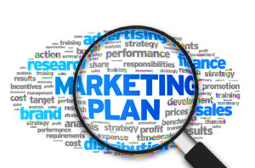
Marketing plan
A document (plan of action) that outlines the current market position of a company, as well as the activities involved in meeting specific marketing objectives for a particular period (e.g. a year).

Slide 11
Marketing plan helps farmers to:
Understand which products are in demand and will provide a profit.
Decide on:
What to plant.
When to plant.
How to produce a crop.
To whom to sell the harvested crop.

Slide 12
Market
The group of consumers or organisations that:
Is interested in a particular product.
Has the resources to buy the product.
Is allowed by regulations and/or legislation to buy the product.

Slide 13
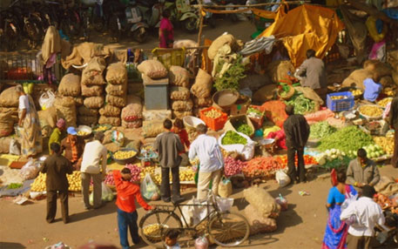
Agricultural market
The group of consumers and organisations that:
  Is interested in a particular agricultural product.
  Has the resources to buy it.
  Is legally allowed to buy the product.

Slide 14
Components of a market
In order for a market to exist, the following components have to be present:
A product that can be bought and sold.
Buyers and sellers.
Business relationship between buyers and sellers.
A particular area, e.g. a region or a country.

Slide 15
Levels in a market
Potential market.
Available market.
Qualified available market.
Target market.
Penetrated market.

Slide 16
Agricultural market vs. market of manufactured goods
The agricultural products are perishable.
Agricultural products are produced and supplied irregularly or seasonally.
Most agricultural products are bulky: therefore, storage and transportation are expensive.
There is a large degree in variation in the quality of agricultural products.
Agricultural products require processing.

Slide 17
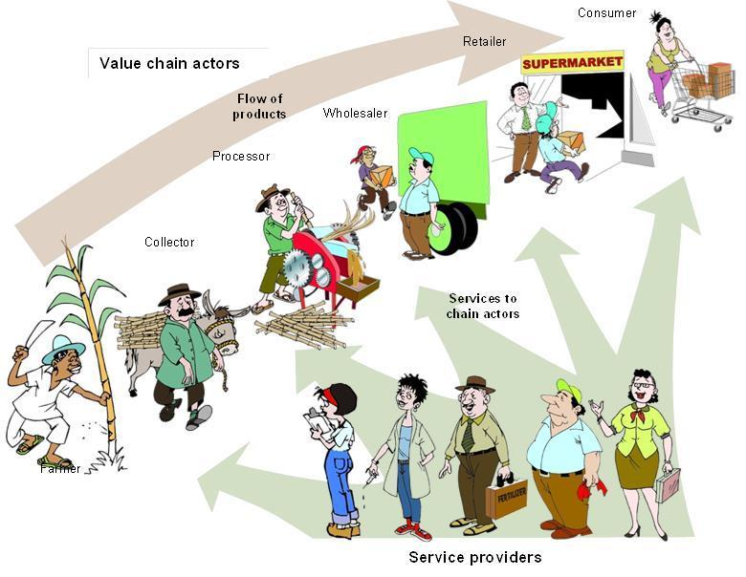
Agricultural value chain
The goods, services and processes involved in an agricultural product moving from the farm to the final customer (consumer).

Slide 18
Activities: agricultural value chain
Input supply.
Farm production.
Post-harvest handling and processing.
Technologies of production and handling.
Grading criteria and facilities.
Cooling and packing technologies.
Storage and transport.
Industrial processing.
Finance.
Feedback from markets.

Slide 19
Market segmentation
The division of an overall market into subsets (segments) of customers with common characteristics.
Market segmentation can be based on geographic, demographic (population) and behaviouristic characteristics.

Slide 20
Market supply
The quantity or amount of a product (maize, potatoes, tomatoes, eggs, and so on) that producers can offer to the market for sale.
The supply of a product depends partly on its price and on local conditions.

Slide 21
Local conditions and product supply
Rainfall, drought and access to water.
Pests and diseases.
Availability of fertiliser and seeds.
Poor roads and transport vehicles.
Poor farmer health and nutrition.
Pregnancy and child rearing: women farmers.

Slide 22
Market demand
The amount of the product that customers are willing and able to buy, which partly depends on the price.
If the price is low, more people will want to buy and each person may want to buy more of the product. If the price goes up, fewer people want to buy and each person will probably buy a smaller amount.

Slide 23
Factors affecting demand
Customers generally want to buy more:
  Staple foods (e.g. maize or wheat) or major vegetables (e.g. onions and tomatoes).
  High-quality products.
  Fresh products.
  Scarce items, e.g. first fruits in the season.

Slide 24
Supply and demand
Understanding supply and demand helps farmers to:
Plan crops – what, when and where.
Grow a more expensive crop variety to be sold for more money.
Grow a more nutritious crop.
Determine best time to sell their crop.
Increase crop quality for higher selling price.

Slide 25
Agricultural market types
Informal markets
Markets that exist beyond the tax system and that are therefore, off record.
Formal markets:
All the businesses, enterprises and economic activities in the agricultural and food sectors that are structured, monitored and protected by government and internationally recognised standards.

Slide 26
Informal agricultural markets
Support all types of products produced by smallholders.
Have no formal grades and no traceability systems.
Rarely use standard measures.
Set prices based on local supply and demand conditions.
Offer few barriers to entry.
Are attractive to smallholder farmers, as they generally get paid in cash on delivery and have few, if any, rules and regulations..

Slide 27
Informal agricultural market types
The farmgate (on the farm).
Roadside sales.
Village markets.
Rural assembly markets.
Sales within the main urban wholesale and retail markets.

Slide 28
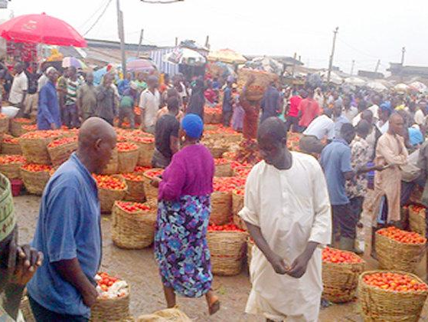
Mile 1 in Lagos (Nigeria)
Example of a massive informal market

Slide 29
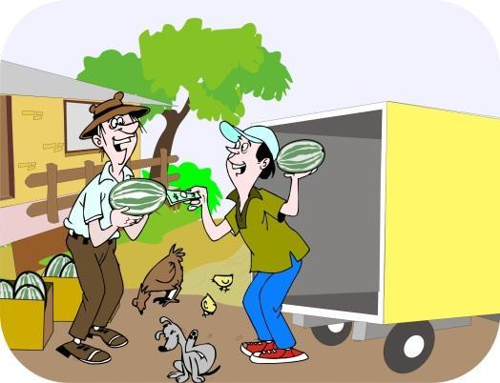
Farmgate markets
Informal markets in which sales occur when farmers sell their products directly from the farm to neighbours or traders.

Slide 30
Informal assembly markets
Farmers and small local traders regularly coming together to sell their goods to larger traders.
The buyers in assembly markets are traders, not consumers.

Slide 31
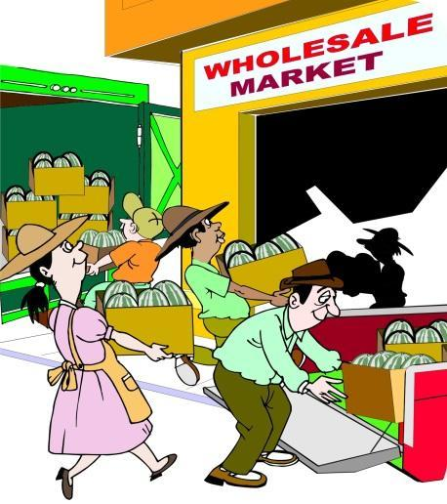
Informal wholesale markets
Markets where traders (and some farmers) deliver produce in bulk.
Generally found on the outskirts of larger towns and cities.
Retailers come to these markets to buy bulk goods.

Slide 32
Informal retail markets
Markets where consumers and small businesses buy their daily or weekly supplies of food.
It is possible for farmers to sell in bulk directly to retail markets. To do so, they must work out a system with the retailer.
Wholesalers may try to prevent farmers from selling directly to retailers.

Slide 33
Formal agricultural markets
Offer more consistent pricing methods and extended seasonal buying.
Highly competitive.
Have strict quality standards.
Meet all levels of food safety regulations.
Invest in information and communication technology (ICT).
Record and share information on prices and volumes.
Invest in storage systems.
Monitor sanitation through the market system.

Slide 34
Formal agricultural market types
Supermarkets.
Food processing markets.
Hotels and restaurants.
Feed markets.
Export markets.

Slide 35
Supermarkets
Supermarkets enable consumers to buy a large variety of different types of goods at the same time.
The food is attractively packaged and of good quality.
Farmers can sell directly to supermarkets if they meet volume and quality requirements.

Slide 36
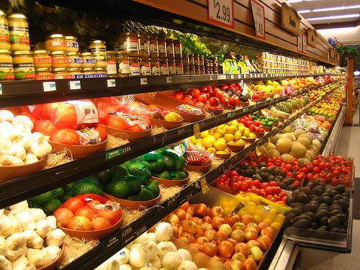
Fresh produce in a supermarket

Slide 37
Food processing markets
As countries urbanise and incomes rise, consumer food habits change towards more processed and packaged foods.
In the food and beverage industries, processors offer farmers and traders new markets and the prospect for long-term stable business relationships.

Slide 38
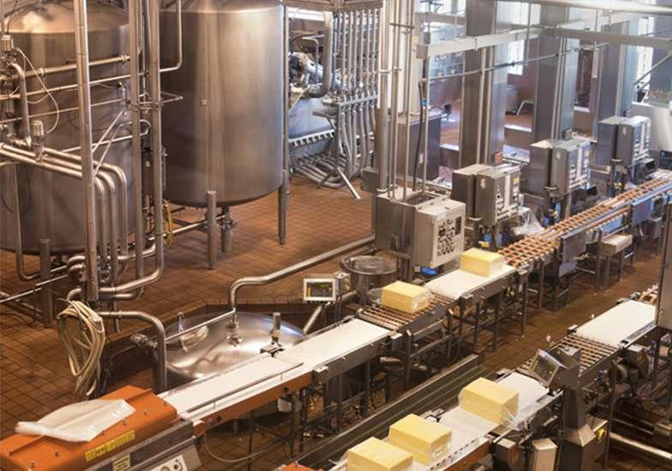
Example of a food processing factory

Slide 39
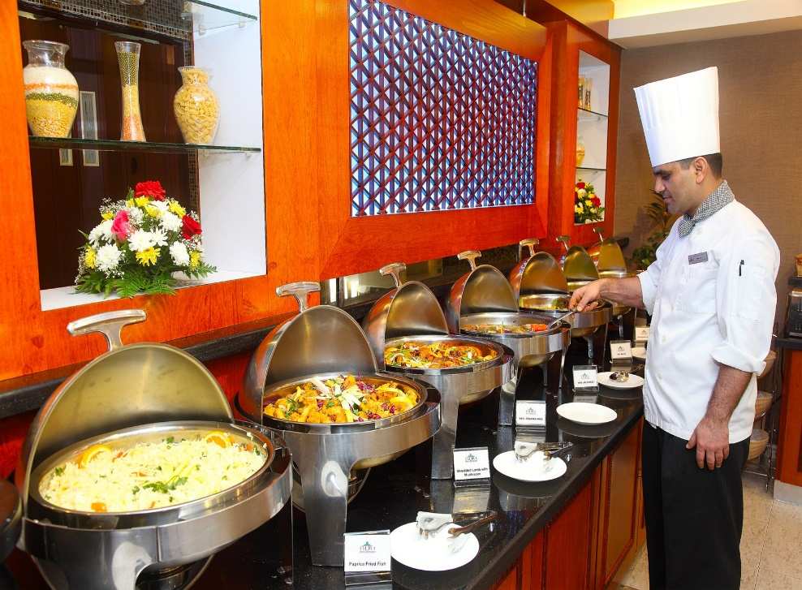
Hotels and restaurants
Hotels and restaurants pride themselves on serving customers with food made with fresh, high quality produce.
Chefs often work directly with farmers or with reliable suppliers of high quality produce.

Slide 40
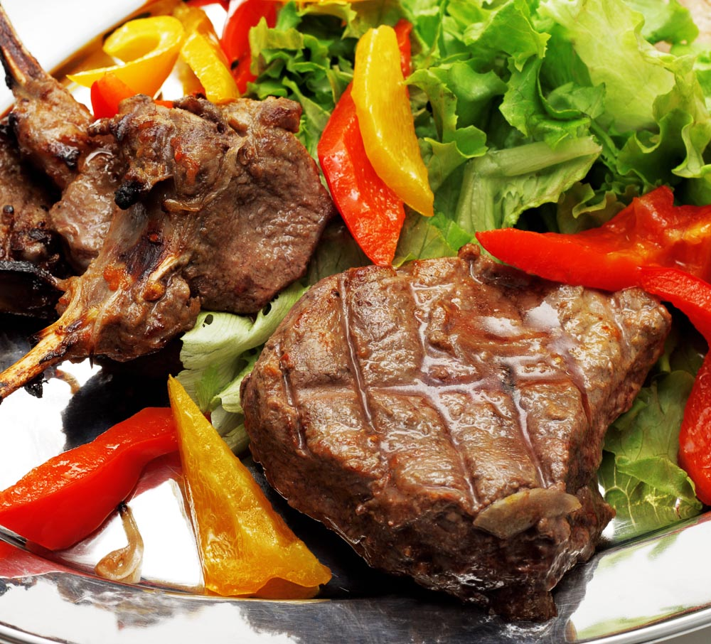
High quality food served in restaurants

Slide 41
Feed markets
In urbanised countries, consumers’ diets include an increasing consumption of meat and milk products, which creates a growing demand for animal feed products, thereby driving another new market opportunity for farmers.

Slide 42
Export markets
Export markets involve goods being produced in one location or country and being sold and consumed in another country.
Export trade traditionally included a mix of food and fibre products, e.g.:
Coffee Cocoa
Tea Cotton
Tropical fruits and nuts

Slide 43
Actors in value chain levels
Level 1: Core value chain actors.
Level 2: Business development services.
Level 3: Regulatory agencies.

Slide 44
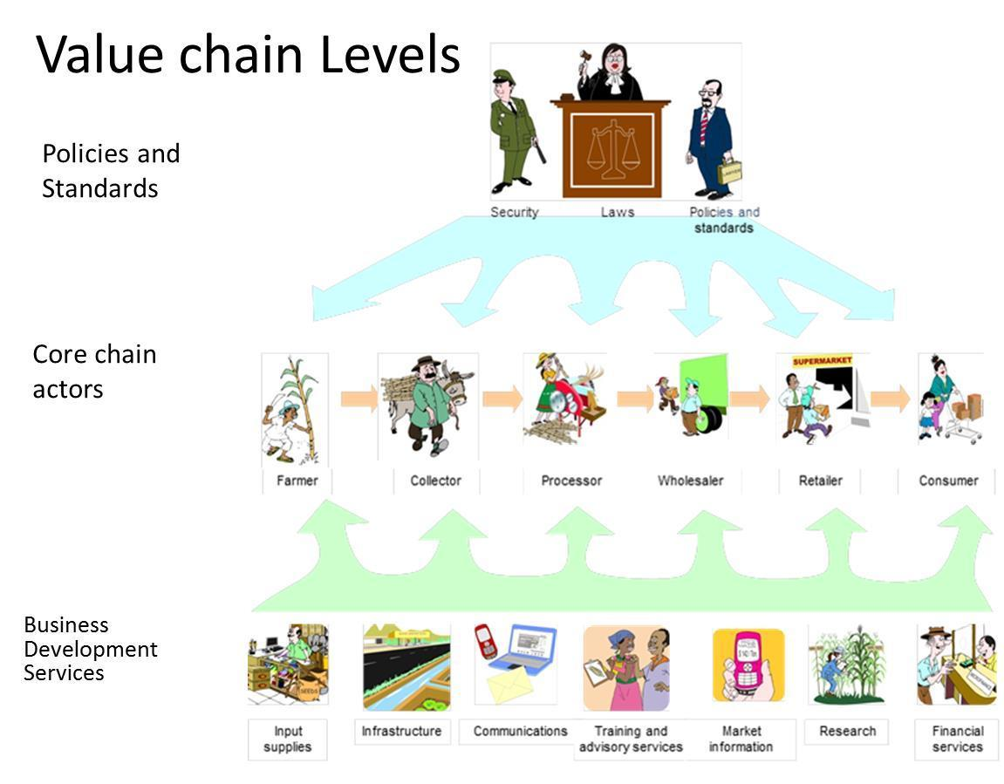

Slide 45
Key value chain actors
Farmers
Collectors
Processors
Wholesalers
Retailers
Consumers

Slide 46
Business development services
People and organisations that support the production, supply and marketing of goods, without owning the product involved.
Operate on the second level in the value chain, and include:
Market access support.
Infrastructure and technology support.
Input supplies and finance.

Slide 47
Key business development service providers
Input suppliers.
Communication services.
Training and agricultural advisory services.
Market information services.
Financial services.
Research support.

Slide 48
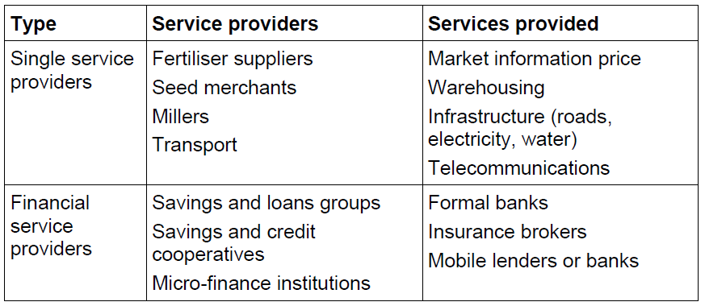
Business development and support services (1)

Slide 49
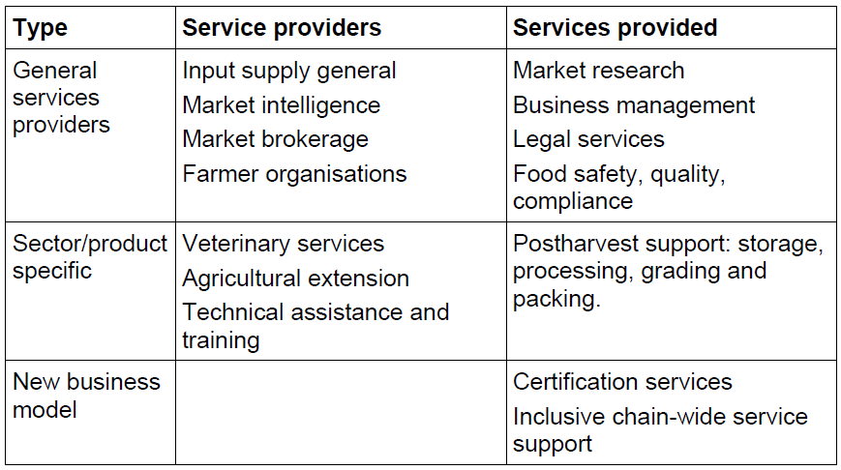
Business development and support services (2)

Slide 50
Key regulators
The actors/role players and agencies on Level 3 in the value chain that set formal and informal policies, standards and legal regulations that govern the way in which the core actors and business service providers conduct their businesses and deliver their products or services.

Slide 51
Food safety issues and standards
Organisations involved in food quality, handling, processing and distribution:
United Nations Food and Agriculture Organization (FAO).
United States Department of Agriculture (USDA).
National food laboratories.

Slide 52

Problems: food safety
Foodborne illness.
Food contaminants.
Pesticide exposure.

Slide 53
Changes: food production, handling, processing and quality
Inspection of domestic products, imports and exports.
Conducting risk assessments.
Educating the public about the importance of food safety.

Slide 54

GLOBALG.A.P.
The world's leading farm assurance programme, translating consumer requirements into good agricultural practice in various countries.

Slide 55
Farmer segmentation
Bill Vorley identified the following three farmer segments:
Rural World 1: Globally competitive farmers.
Rural World 2: Locally orientated farmers with access to land and multiple enterprises.
Rural World 3: Farmers with fragile livelihoods, limited access to resources.

Slide 56
Categories of livelihood strategies
Andrew Dorward identified the following three types of livelihood strategies:
Stepping up.
Hanging in.
Stepping out.

Slide 57
Types of extension agents
National government agricultural extension agents.
NGO agricultural extension agents.
Lead farmers and community based agents.
Volunteer agents and mobilisers.
Commission agents.
Fee-based agents.
Private sector field agents;
Partnerships.

Slide 58
Using market analysis tools
Study Unit 2

Slide 59
Overview
Study unit 2 is about:
  Identifying market strategies and interventions.
  Explaining MOI process.
  Identifying market opportunities.
  Identifying key points in value chain analysis.
  Identifying steps involved in value chain analysis.

Slide 60
Market strategies
Livelihood strategy.
Value chain upgrading strategy.
Intermediary firm business model.
Inclusive business model.

Slide 61
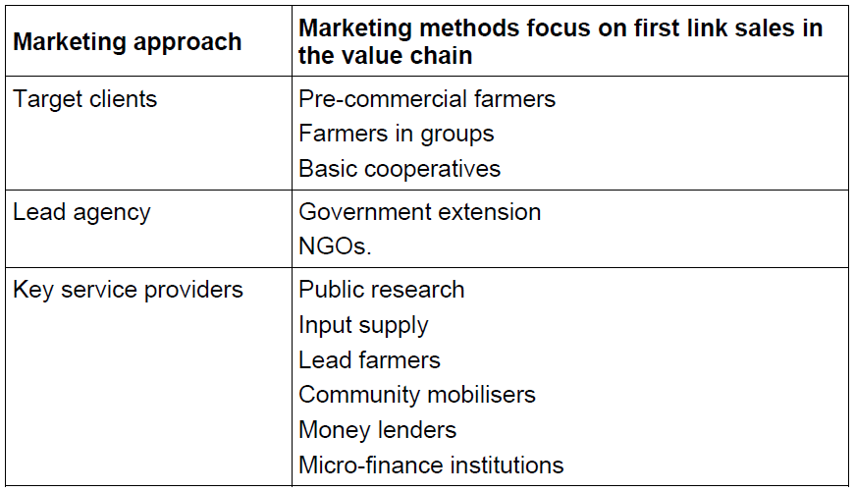
Livelihood strategy (1)

Slide 62
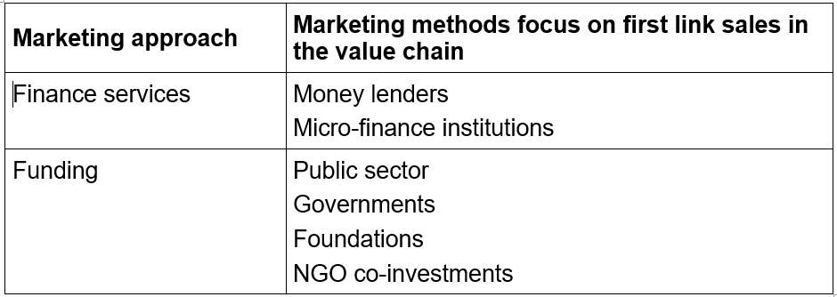
Livelihood strategy (2)

Slide 63
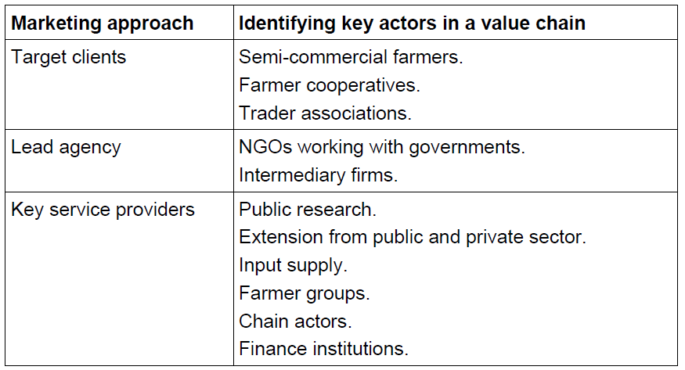
Value chain upgrading strategy (1)

Slide 64
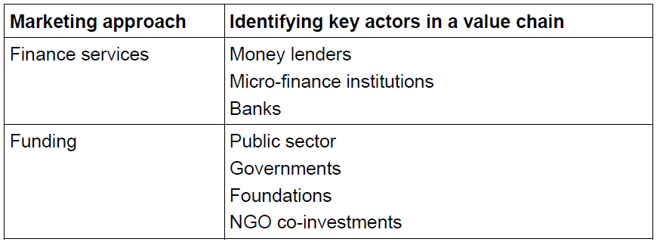
Value chain upgrading strategy (2)

Slide 65
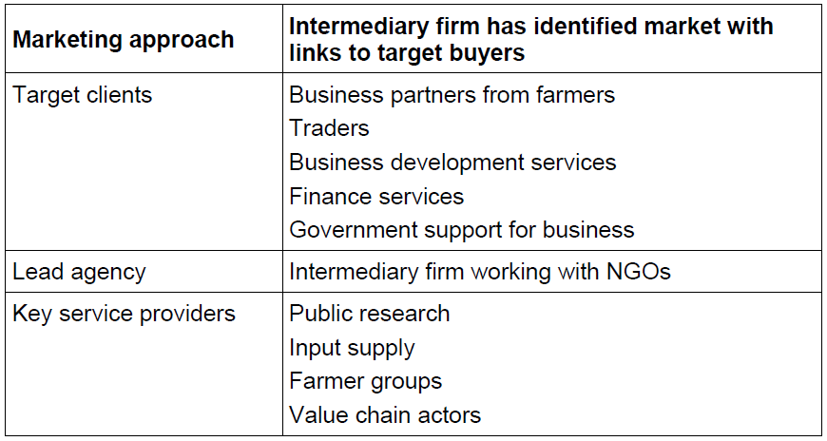
Intermediary firm business model (1)

Slide 66
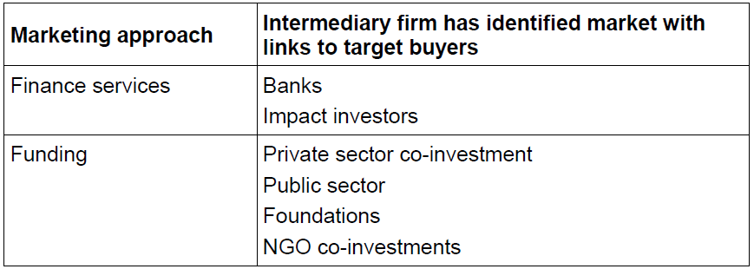
Intermediary firm business model (2)

Slide 67
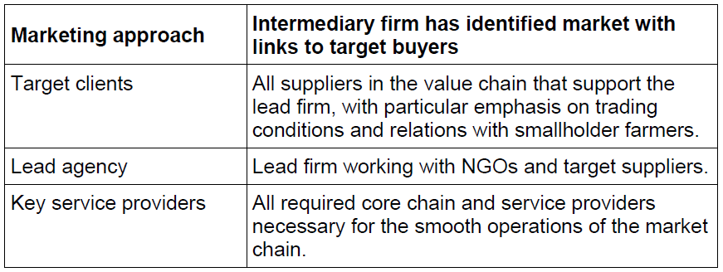
Inclusive business model (1)

Slide 68
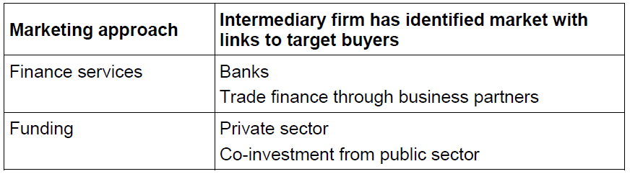
Inclusive business model (2)

Slide 69
Market opportunity identification
MOI is a systematic, participatory method for collecting market information to identify and select products and services for investment and agro-enterprise development.

Slide 70
MOI: Aim
The aim of MOI is to help agents and farmers to:
Collect market information to identify and select products for investment and development.
Evaluate market demand for a range of products.
Select products of most interest to a farmer, farmer group, or cooperative;
Decide which market strategy to pursue;
Compare different products and explore market options for value added products.

Slide 71
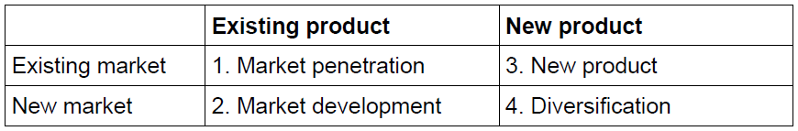
Market strategies
Based on the type of product and market, farmers can invest in the following four main types of market strategies:

Slide 72
Steps in the MOI process
STEP 1:
Organise a market suvey team
STEP 4:
Conduct a detailed analysis
STEP 5:
Select product with clients
STEP 2:
Design a MOI questionnaire or checklist
STEP 3:
Assess and select market options

Slide 73
1: Organise the survey team
Market survey team:
Can be a farmer, farmer group or a cooperative team.
Collects information from the farmer group and information from the market.
Analyses the collected information.
Prepares an investment plan or works with farmers to decide on a product for further investment.

Slide 74
2: Design a survey questionnaire
Examples of survey questions:
Where can the buyers be reached?
What are the trends in demand for the products?
Which products in the market are in highest demand and why?
Which products are in low supply and why?
What are the price of the main products of interest?
What is the seasonality of the main products of interest?
What are the buying conditions?
What are the terms of payment?

Slide 75
3: Assess and select market options
A filtering process – based on a set of discard criteria – is used to select and remove some market options and decide on the best investment options.

Slide 76
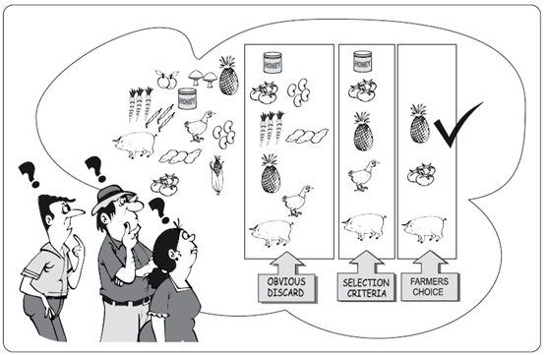
Three levels of product filtering

Slide 77
4: Conduct a market analysis
The results of the detailed market analysis are used to determine:
Production requirements.
Expected yields.
Product demand.
Costs.
Potential profit levels.
Investment needs.
Return on investment (ROI).

Slide 78
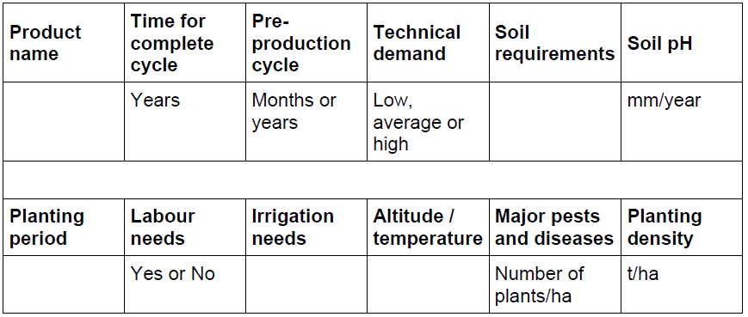
Product data collection
Example of a product data collection form

Slide 79
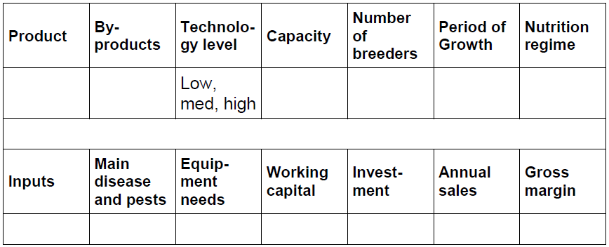
Livestock production collection
Example of a livestock data collection form

Slide 80
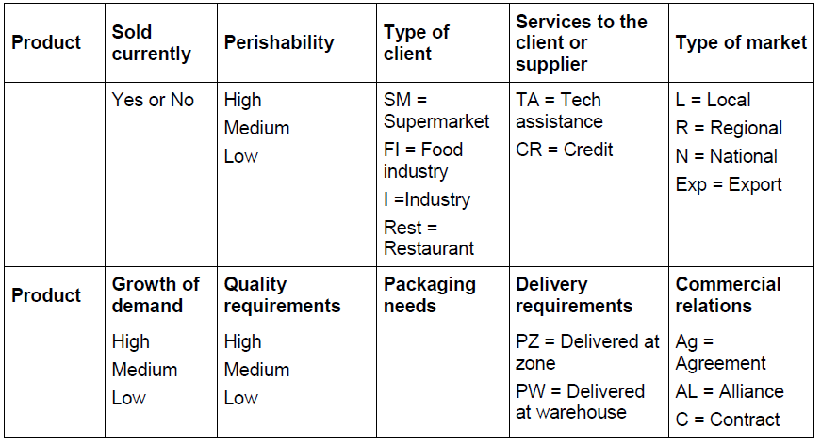
Marketing data collection
Example of a marketing data collection form

Slide 81
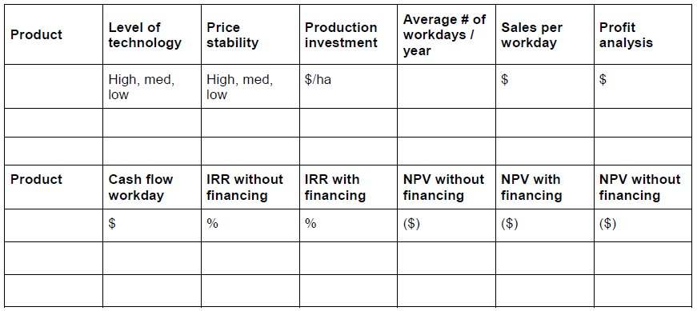
Financial data collection
Example of a financial data collection form

Slide 82
Profitability analysis
The profitability analysis focuses on elements such as:
Cost of production.
Expected revenue (income), based on past experience/unit area.
Gross margin.

Slide 83
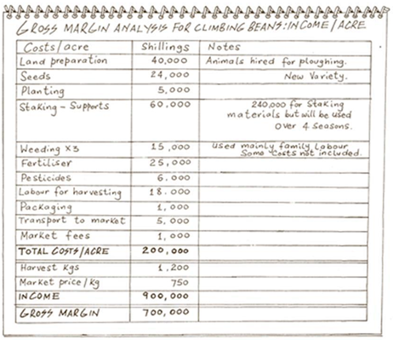
Example of a profitability analysis

Slide 84
5: Select products with clients
The detailed MOI survey provides farmers with information on the:
Production requirements.
Market demand.
Financial costs and revenues for a specific product.

Slide 85
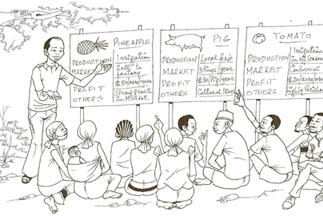
Sharing survey results with farmers

Slide 86
Value chain analysis
A more extensive analytical method, which provides a systematic process to:
Assess market options.
Change the existing buying and selling culture from the occasional and opportunistic sales transactions a more consistent sales approach.

Slide 87
Steps in the value chain analysis
1. Select the survey team.
2. Identify key issues for analysis.
3. Conduct a literature review.
3. Select market and key informants.
5. Map the market chain.
6. Prepare a market survey questionnaire.
7. Visit markets and key informants.
8. Collection information on opportunities to improve trading relations.
9. Analyse data from surveys.
10. Prepare a series of reports.

Slide 88
1: Select the survey team
The survey team is responsible for:
Collecting information.
Conducting the analysis.
Writing the final report.

Slide 89
2: Identify key issues for analysis
Examples of key issues:
Commodity characteristics.
Consumption patterns.
Supply situations.
Prices.
Operation of marketing systems.
Government, marketing institutions and policies.
International trade.

Slide 90
3: Conduct a literature review
Literature review is a critical assessment (evaluation) of the literature (secondary information sources) related to the value chain survey, in order to obtain information on:
The production and marketing system.
Gaps to be filled by the primary data.
The essential background for subsequent fieldwork and analysis.

Slide 91
Sources of secondary information
Official statistics from statistical departments.
Ministries of agriculture, trade or finance.
Donor agencies.
The Internet.
NGO reports.
Specialised journals.
Bulletins and newsletters.
Documentation of trade associations and chambers of commerce.
Other rural development projects.

Slide 92
4: Select key informants
Two types of key informants:
Market participants: The actors involved in the production, marketing and processing of the agricultural commodity being analysed.
Knowledgeable observers: Insightful, knowledgeable people who can offer a broad, and sometimes detailed, perspective on the sub-sector.

Slide 93
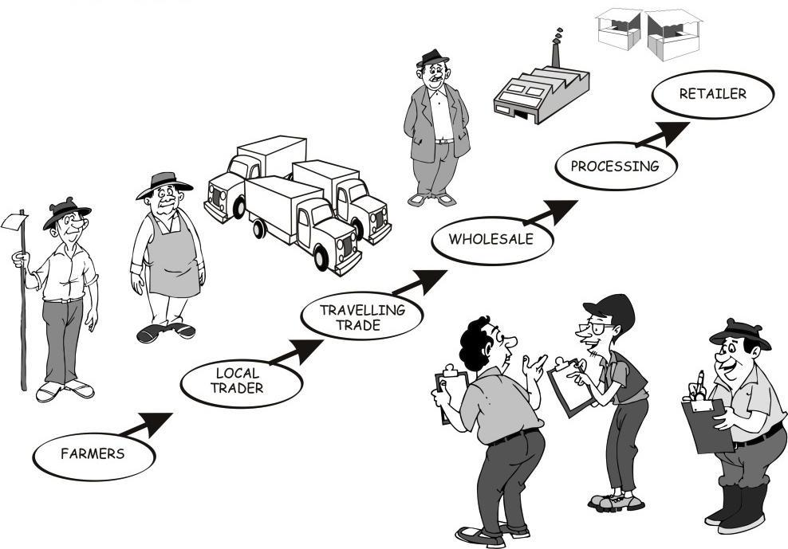
Key informants in the value chain survey

Slide 94
Key informants: Sample
The population refers refers to the entire group of persons (key informants) that should be studied/interviewed.
A sample is a selected group that is defined from the population

Slide 95
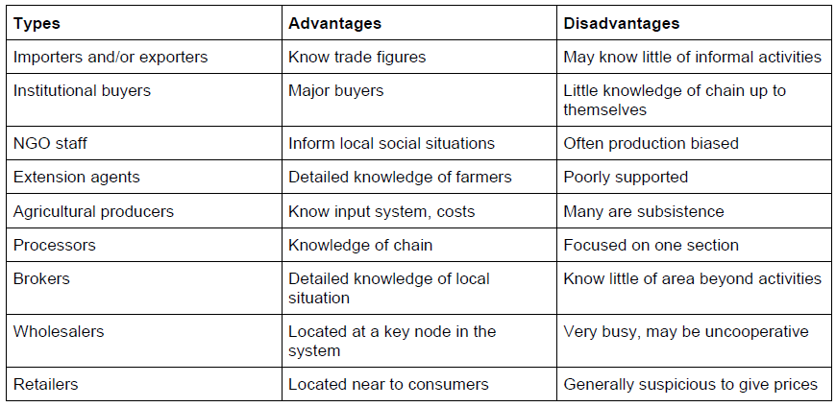
Key informants in the sample

Slide 96
5: Map the value chain
First level sketch of the existing market chain answers the following questions:
Who are the known actors in the market chain?
Who are the core chain actors?
Who are the service providers?
Where are they located?
What are their roles or functions?
How do they relate to each other?

Slide 97
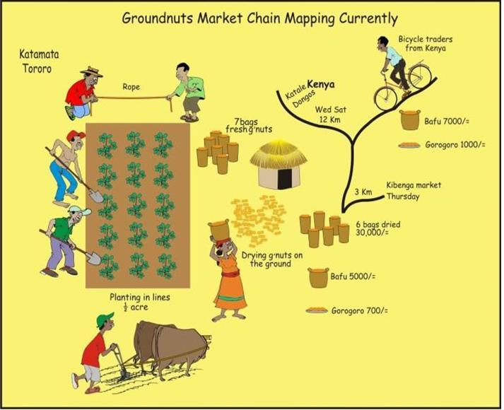
Example of a market chain map

Slide 98
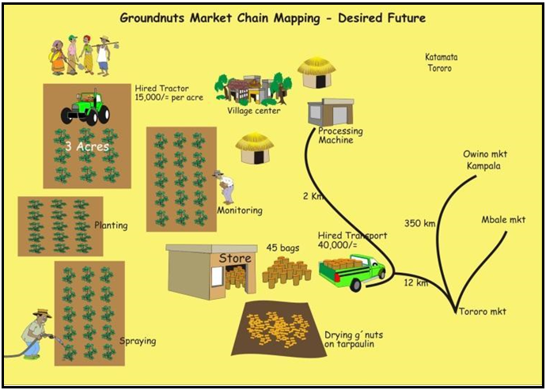
Groundnuts market chain mapping

Slide 99
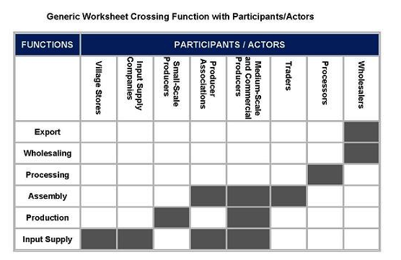
Example of a market chain map in tabular format

Slide 100
6: Prepare a survey questionnaire
Examples of questions:
Is the market for this product growing, stable or declining?
Who buys the product?
How big is the market?
How many similar buyers are there?
What are the purchase conditions?
What is the form of payment?
Are there price fluctuations during the year?

Slide 101
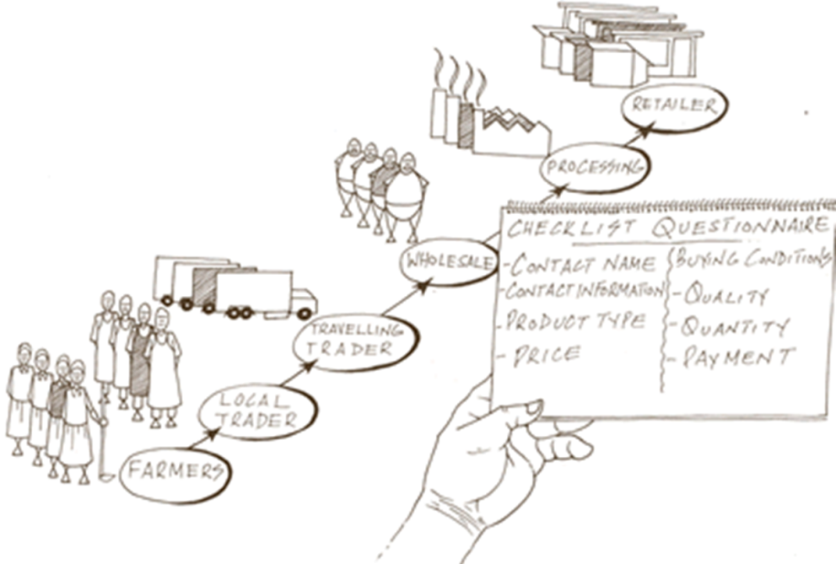
Example of a value chain analysis checklist

Slide 102
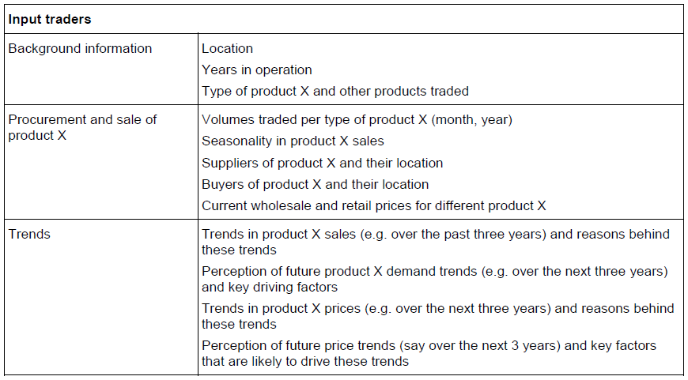
Example of a detailed checklist (1)

Slide 103

Example of a detailed checklist (2)

Slide 104
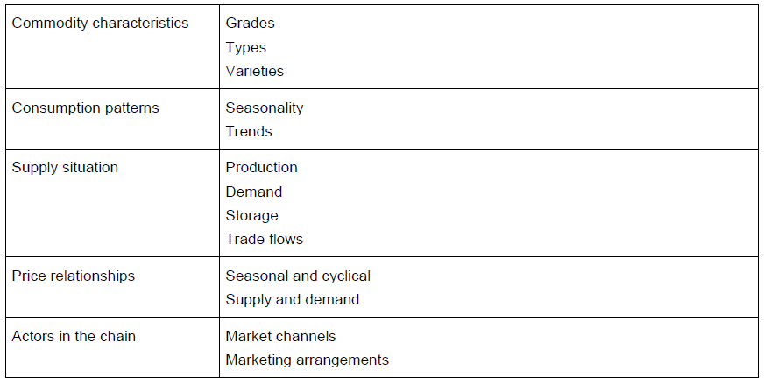
Example of a short checklist (1)

Slide 105
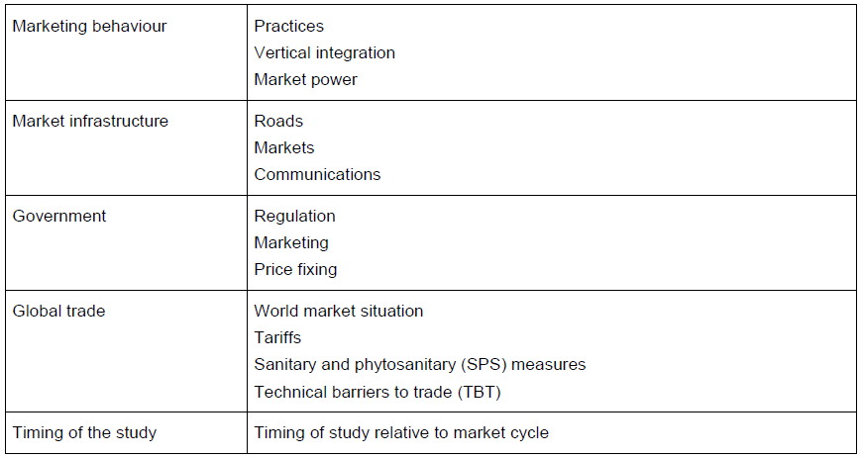
Example of a short checklist (2)

Slide 106
7a: Survey time in the field
Time in the field is determined by:
Target product;
Number of market places visited;
Number of key informants selected; and
Type of information required.

Slide 107
7b: Survey sequencing
Option 1: Start by interviewing exporters or larger traders in wholesale and terminal markets, which will give you an immediate overview of the market scope.
Option 2: Start with focus group discussions at the farmer community level and then move down the market chain.

Slide 108
7c: Data collection tools
Focus group;
Product ranking and prioritisation;
Historical calendars;
Market mapping;
Evaluation of service provision;
Market visits;
Learning journeys;
Checklists or semi-structured interviews;
Structured interviews;
Direct observation.

Slide 109
7d: Interview guidelines
Introduce yourself and your organisation.
Always be polite and professional.
Be clear about the purpose and timing of the interview.
Stress confidentiality.
Follow a logical sequence in your questioning.
Ask simple and clear questions: one idea at a time.
Avoid leading and complicated questions.
Ask most sensitive questions last.
Do not ask prices until later in a conversation.
Be prepared to listen and learn.
Engage the respondent (key informant).

Slide 110
8a: Cross checking
Mirror imaging.
Triangulation.
Observation.
Supervision of interviewers.

Slide 111
8b: Updated marketing maps
Digital data collection systems and digital survey tools enable survey team members to:
Collect information on locations.
Take photos and create videos.
Record audio files.
Link all this information to the data upload.

Slide 112
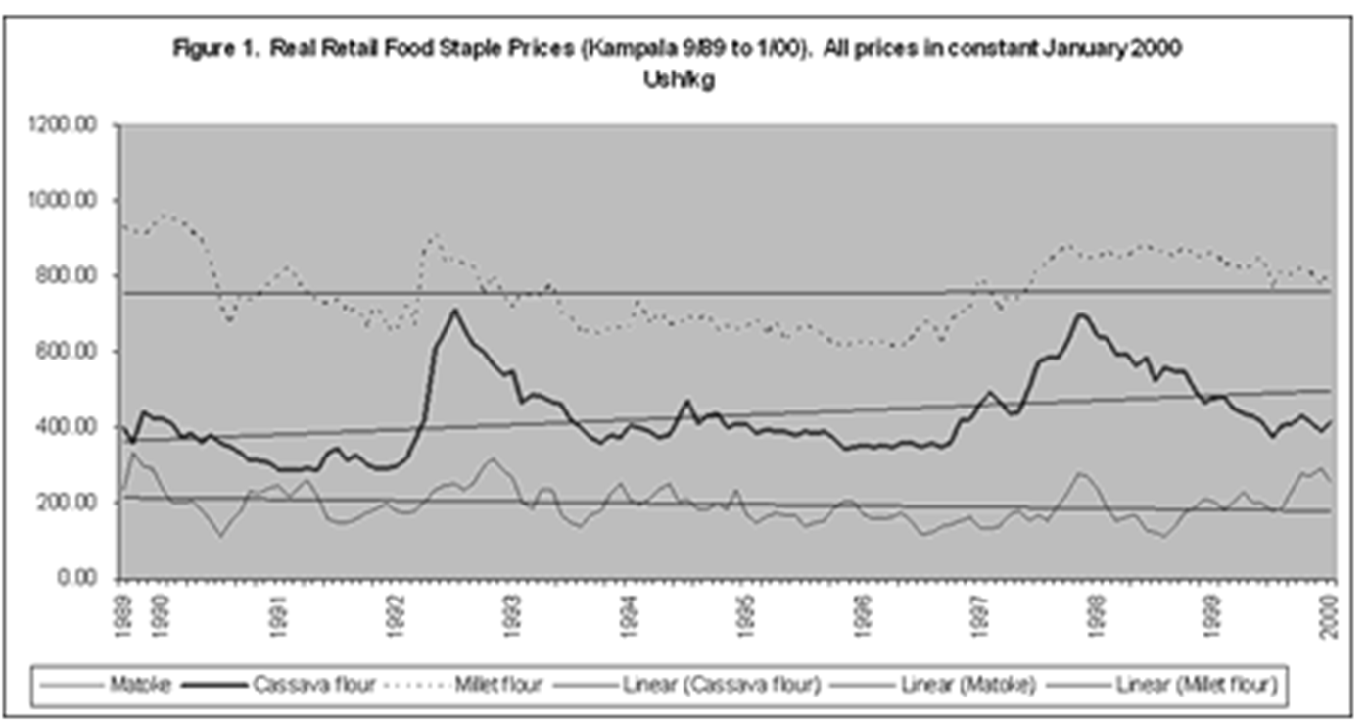
8c: Trend analysis
Example of a trend analysis graph

Slide 113
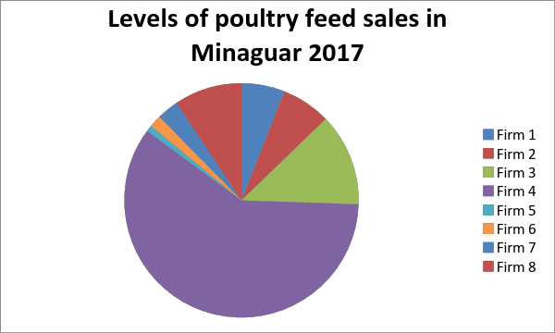
8d: Market volume trend
Example of market volume trends

Slide 114
8e: Projection and regression
Example
  Rice production in Vietnam was approximately 39.1 million metric tons (mt) in 2009/10 (26.1 million mt, milled basis). Vietnam used to be a major exporter of rice, but with increasing population, these exports are declining.
Depending on the amount exported in a given year, (estimated 5% export level), the total consumption level would be 2,479,000 mt. Given a growth rate of 2.4%, the demand for rice on a population growth rate alone will increase by approximately 59,508 mt/year.

Slide 115
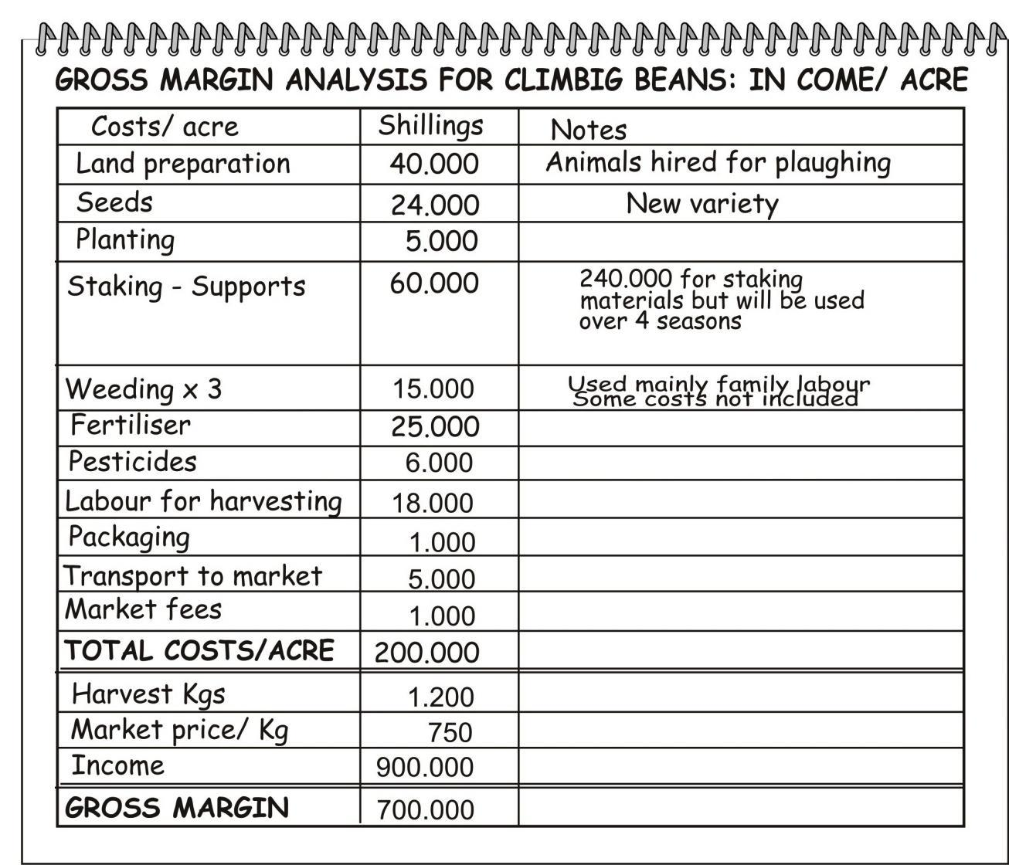
8f: Gross margin analysis
Example for bean production

Slide 116
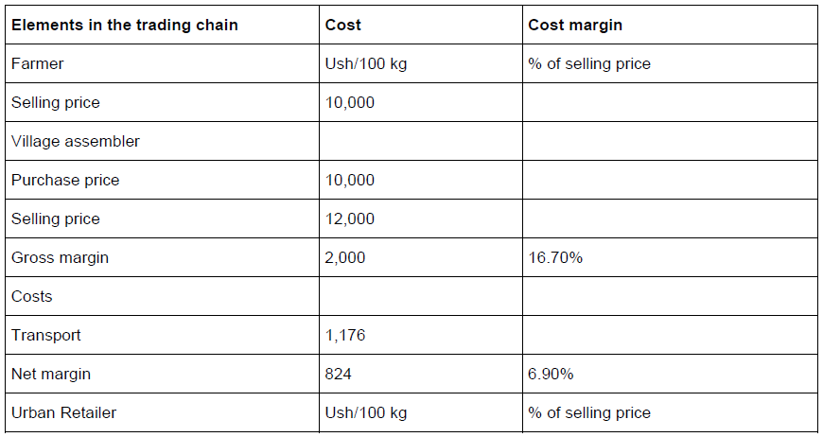
8g. Margin analysis (1)
Example of a margin analysis

Slide 117
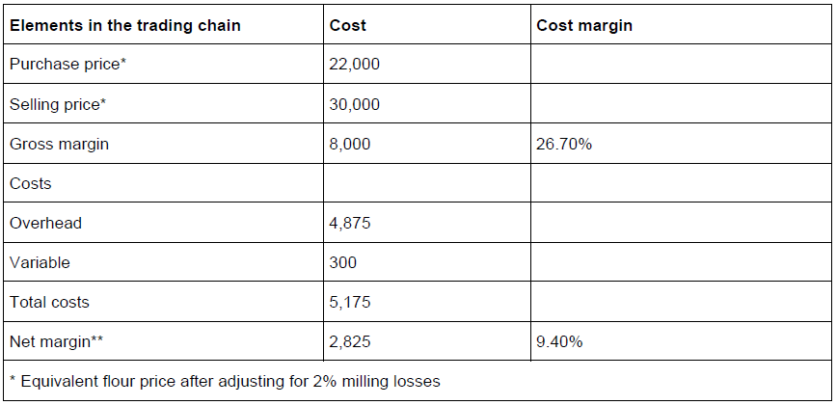
8g. Margin analysis (2)
Example of a margin analysis

Slide 118
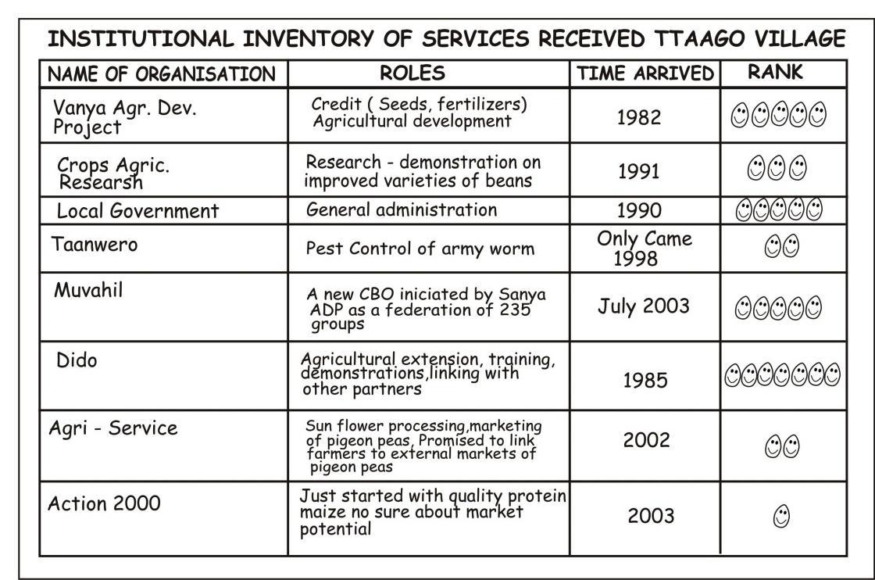
8h: Evaluation of BDS providers
Example: Institutional inventory services at Ttaago Village (Tanzania)

Slide 119
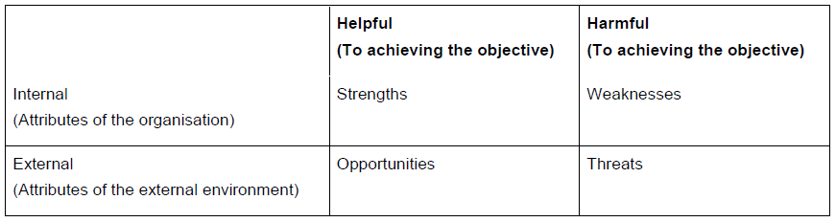
8i: SWOT analysis (1)

Slide 120
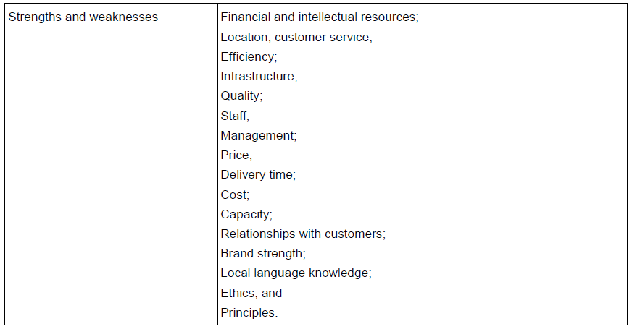
SWOT analysis (2)
Issues to be reviewed in a SWOT analysis

Slide 121
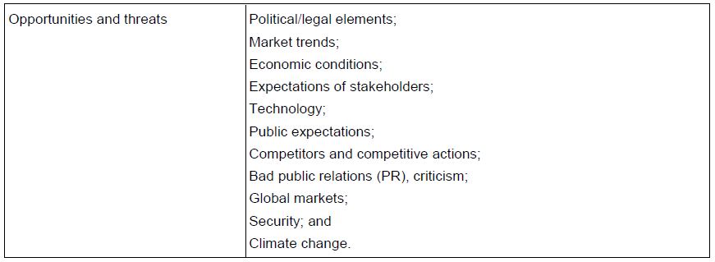
SWOT analysis (3)
Issues to be reviewed in a SWOT analysis

Slide 122
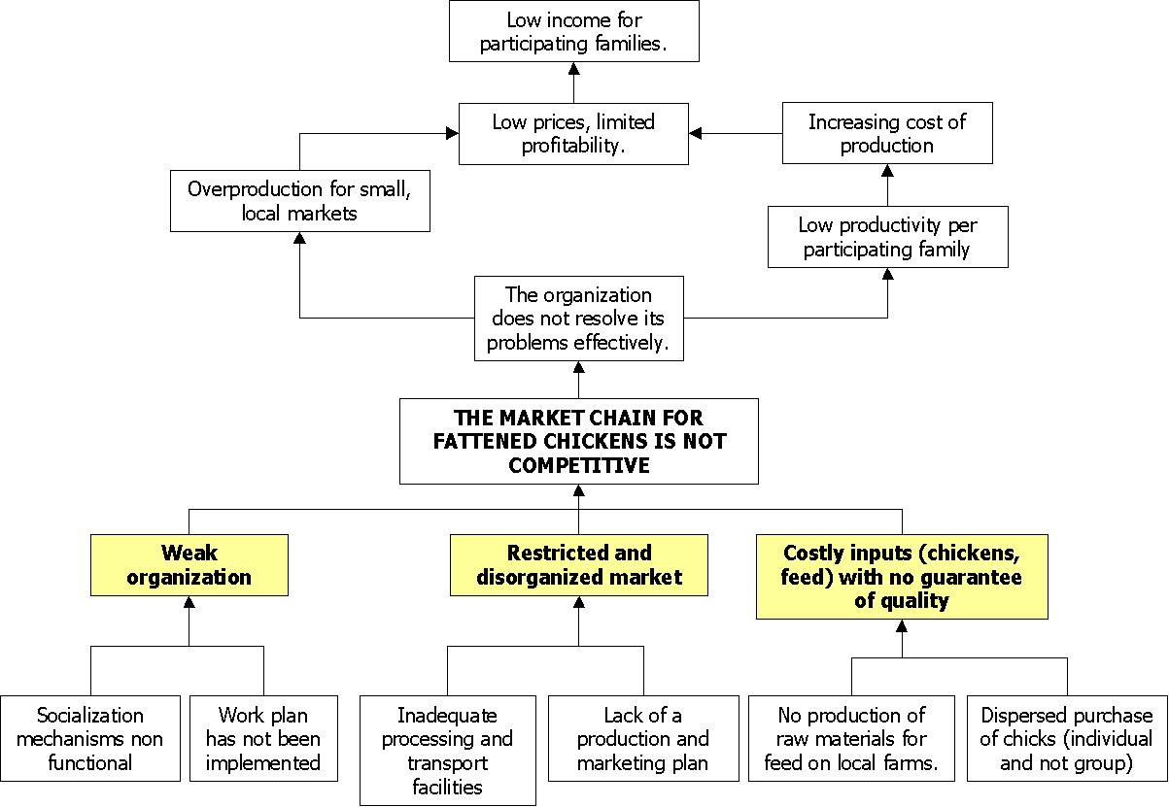
8j: Problem tree analysis
Example of a problem tree

Slide 123

8k: VC: Solution tree
Example of a solution tree for improving market competitiveness of chickens

Slide 124
8l: Scenario building
Example
The marketing team who worked with potato farmers in south western Uganda, considered the following market options for the farmers:
Sales of potatoes into the local market;
Sales of potato into the nearest large city, 80 km from the farms;
Sales of potato into a fast food restaurant in the capital city 400 km away; and
Sales of potato into the wholesale market in the capital city.

Slide 125
9: Results and interpretation
Answer the following questions:
What are the different channels and key stages in the value chain?
What are the main production areas and wholesale and consumption centres?
What are the scales of operation at each stage of the value chain?
Who are the key players?
How profitable is this value chain for target producers, traders and processors?

Slide 126
9a: Preliminary diagram of the marketing chain
The survey team may consider the preliminary maps/diagrams:
Core chain actor’s map.
Business services map.
Infrastructure.

Slide 127
9b: Results: Demand study
Identify the major products, markets and market chains.
Provide figures on the size of these markets and total market demand.
At the product level, provide information on price, volume, trends, etc.
Prioritise products in terms of where the enterprise can increase sales and product value, and volume of trade.
Record the names of traders, buyers and processors.

Slide 128
9c: Results: Supply study
A map of the country, district and production zones of the selected commodity.
Information on the seasonality of production.
Seasonal and trend information on prices of the target raw.
Marketing costs along the value chain.
Flows of the commodity through the main supply chains.

Slide 129
10: Recommendations
Relevant key questions:
Has this intervention/solution been applied before?
If it has been applied, what are the reasons for its failures or successes?
If it has failed, but still has merit, what must be done to ensure success?

Slide 130
11: Survey report
Survey report structure:
Executive summary.
Introduction.
Target clients for the study.
Methodology.
Key findings.
Specific recommendations to the target clients.
Conclusions and annexures.

Slide 131
Value chain upgrading strategies
Study Unit 3

Slide 132
Overview
Study unit 3 is about:
Identifying the assumptions and decision points in value chain upgrading.
Explaining the value chain investment process.
Assessing value chain upgrading strategies on farmer and extension agent level.
Designing a business plan for the implementation of a value chain upgrading strategy.

Slide 133

Key areas in value chain upgrading

Slide 134
Assumptions and decision-points
There are capable, organised farmers who share a common vision.
There are capable extension services to support a chain wide intervention.
There are willing buyers.
Value chain partners are willing to commit to an upgrading process.
There are available funds and or access to financing for upgrading processes.
The business development services are in place.

Slide 135
Chain wide development
Three different groups of service providers had skills in and supported:
Farmer to first link buyer.
Intermediary firm to canning factory.
Factory to retail.

Slide 136
Farmer upgrading strategies
Commercialising smallholder farmers.
Shifting the competency model from production to business services.
Factors affecting market access.
Farmer organisations to support collective marketing.

Slide 137

Organised farmer organisation

Slide 138
Extension agent upgrading strategies
Acquisition of knowledge, competencies and advisory skills.
Training opportunities in the NGO community.
Training opportunities in the project setting.

Slide 139

Training cascade in the project setting

Slide 140
Market linkage methods
Study unit 4

Slide 141
Overview
Study unit 4 is about the key skills needed to run a farming enterprise, including:
Changing rural communities.
Marketing strategies used by smallholder farmers.
Ways in which extension agents can help farmers to understand their market options.
Basic concepts I value chains and market linkage;
The use of value chain methods for market linkage.

Slide 142

Modern rural communities
Are varied and complex in operations.
Have diverse sources of income.
Seek alternative options for learning, generating business opportunities and improving the lives of family members.

Slide 143
Marketing strategies and approaches
Opportunistic market sales.
Informal sales agreements.
Contract farming and marketing.
Vertical integration.
Certification schemes.
Inclusive business models for sustainable trading relationships.
Shifting from production to market chain approaches.

Slide 144
Terminology
Market chain: A set of linkages between actors with no binding or sought-after formal or informal relationships.
Supply chain: A market chain that supplies a particular customer, meeting their particular product specifications and procedures.
Value chain: A specific type of supply chain in which actors support one another, so that they can increase their overall efficiency and competitiveness.

Slide 145


Slide 146
Key steps: value chain approach
Target products and locations for development.
Analyse the market.
Select partners.
Identify and organise farmers.
Prioritise investments along the chain.
Provide farm level and chain actor support.
Business development services and financial services.
Policy review and analysis.
Chain wide support.

Slide 147
Importance: value chain approach
End markets and levels in the value chain.
Power dynamics and governance.
Quality relationships between actors in the value chain.

Slide 148
Beyond value chains
New approaches should consider the profile of farmers in terms of:
Will the next generation of farmers be younger than the current average of 55 years?
Will they be better educated?
Will more farms be fully operated by women when the men migrate to urban jobs?
Will farm sizes continue to reduce or will there be a new type of rural investor who starts to collect land to improve the economies of scale for farm lots?

Slide 149
Analysing markets and value chains
Study unit 5

Slide 150
Overview
Study unit 5 is about:
Defining the type, scale and level of market analysis.
Outlining the nature and use of the most important toolkits and approaches to value chain development.

Slide 151

Market analysis
The study of the demand and supply characteristics and actors for a product or a sub-sector within a defined geographic area.

Slide 152
Market analysis information
Market size, demand and growth rate.
Market locations and market flows.
Key actors in the market.
Trends in the market.
Product grades, prices, volumes and quality.
Distribution channels.
Investment levels and cost structure.
Success and risk factors.
Market profitability.

Slide 153
Key interest areas
Demand analysis (growth, trends, potential);
Supply analysis (actors, margins, bottlenecks).
Major challenges (threats) and opportunities (technology, organisation, services, policy).
Realistic business opportunities (maturity of the market and client focus).

Slide 154

Levels of market analysis (1)

Slide 155

Levels of market analysis (2)

Slide 156
Clients of market analysis
The type of market analysis and the level of detail in a market report depends on:
Who is financing the study.
Who is conducting the analysis.
The intended level of investment based on the study.

Slide 157
Geographic and product scope
Global analysis.
Sub-sector market analysis.
Territorial analysis.
Community level market analysis.
Value chain analysis.

Slide 158
Dimensions: value chain process
Core chain actors.
Business development services.
Regulatory and policy actors.

Slide 159
Value chain analysis information
Supply chain diagram.
Price graphs (seasonality, trends, etc.).
Price margins along the value chain.
Problem tree analysis.
SWOT analysis.

Slide 160
Toolkits: value chain development
Microlinks.
Making markets Work for the Poor (M4P).
Territorial approach to agro-enterprise development.
SMART skills for smallholder farmers.
Integration with digital information systems.
ValueLinks.
LINK method.
Chain-wide learning for inclusive agri-food market development.

Slide 161


Acknowledgements
This module was made possible through the support of the Deutsche Gesellschaft für Internationale Zusammenarbeit (GIZ) and United States Agency for International Development (USAID).
The contents of this module are the responsibility of the authors and do not necessarily reflect the views of GIZ and USAID or respective their governments.
All work by Global Forum for Rural Advisory Services is licensed under a CC BY-NC 3.0 Unported License

